Slide 1
Banking & Financial Services

Slide 2
Contents
Scenarios
Lead Management System Efficient management of sales leads & communication
B2C Chat Center Perform live chat with citizen customers
Easy Approvals Enhanced Customer Support
For each scenario:
Scenario Vision
Primary Persona
Scenario Storyboard
Solution Design Best Practices
Solution Architecture

Slide 3
Lead Management System
Banking & Financial Services Book of Dreams

Slide 4


Scenario Vision
Relationship Manager
Context
Daniela is a relationship manager (RM) at Contoso Banking. She is part of a team that covers personal, home and car loan products for customers.
Every quarter, Daniela gets assigned a set of targets in terms of number of leads, dollar value and products sold. In addition to these business targets, Daniela also has a set of operational metrics
Current State
The metrics and quarterly targets are sent by the manager to Daniela over emails. It is upto each RM to keep a track of their progress toward goals and plan their strategy to achieve the same
Leads were also sent to each RM as a dump of excel e-mails. RMs use their excel trackers to mark changes in the lead status.
At the end of every week or once in two weeks, Daniela updates the CRM with the lead information
Daniela uses a variety of 3rd party tools and apps to keep track of her action items, follow ups. She misses a few follow-up meetings as information is scattered across different systems
Opportunities won and opportunities lost were reported in CRM but difficult to track the various activities that led to a result unless the RM is diligent in updating
There is little to no analytics on RM velocity, time to close deals leading to lack of forecasts and scrambling to reach targets
Future State
Leads management app on Teams publishes the targets right within Teams and allows RMs to get in touch with managers for queries
Leads are neatly laid out in a filterable list view. App also proactively identifies insights about each lead with a conversion confidence score
Any activities on the lead such as e-mail contact, calls, follow-ups are automatically logged to CRM backend
The app handles lead status tracking, action items, follow-ups, scheduling meetings, mails and texts reducing context switch
App proactively nudges RMs to take action on planned leads for the day, scheduled follow-ups and even provides talking points
Based on the time to close of deals in the past, assigned leads confidence scores, the app provides an estimate of conversions to be made each week to achieve the quarterly targets
- Points of Friction

Slide 5

Daniela Mandera, Banking Relationship Manager
Daniela is a relationship manager at Contoso Banking. She is one of the top performers in the organization. She is excellent at customer relationship management and people skills. One of the primary challenges she faces is maintaining logs of her customer interactions in multiple tools and platforms.

Slide 6
Daniela’s manager announced the sales targets for the upcoming quarter. Once finalized, Daniela is responsible for meeting the targets, converting leads to customers

Slide 7
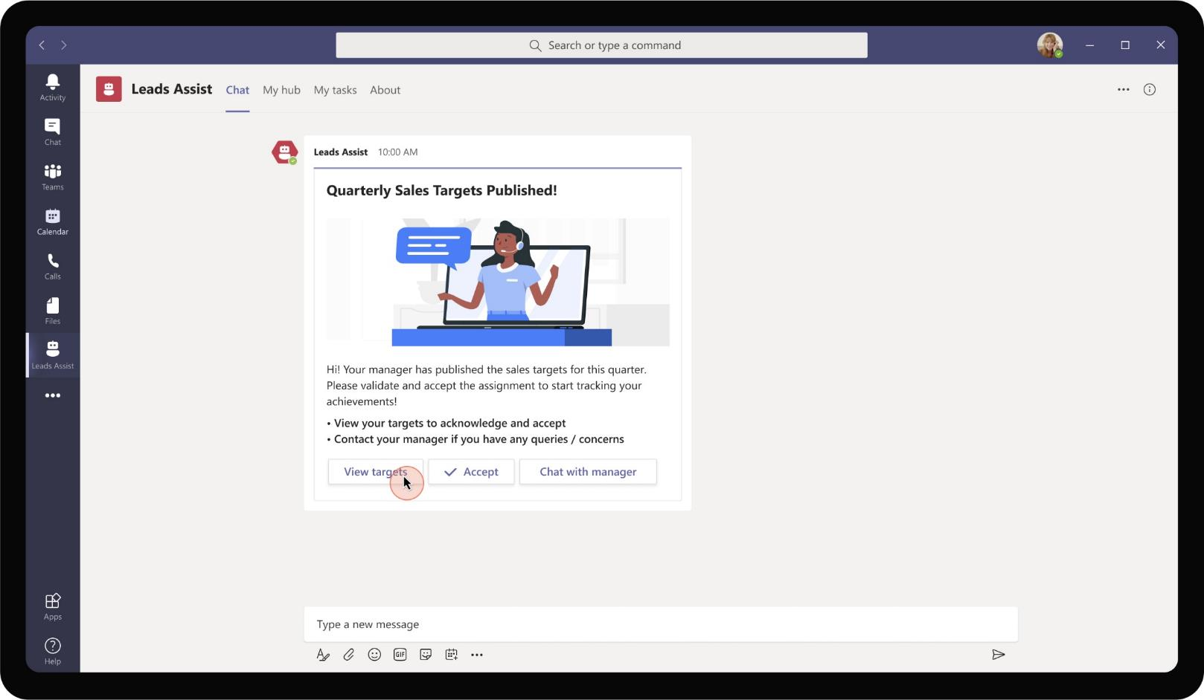
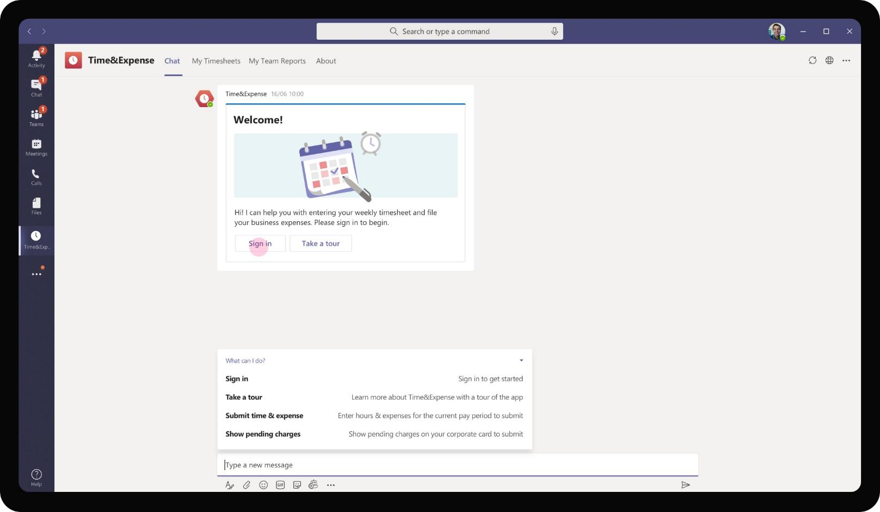
Banking & Financial Services – Lead Management System
As Daniela’s announces the targets for the upcoming quarter, the app notifies each relationship manager in the team with the new targets for the quarter. The RMs have an option to chat about discrepancies in the target or raise any concerns if required directly from the app

Slide 8
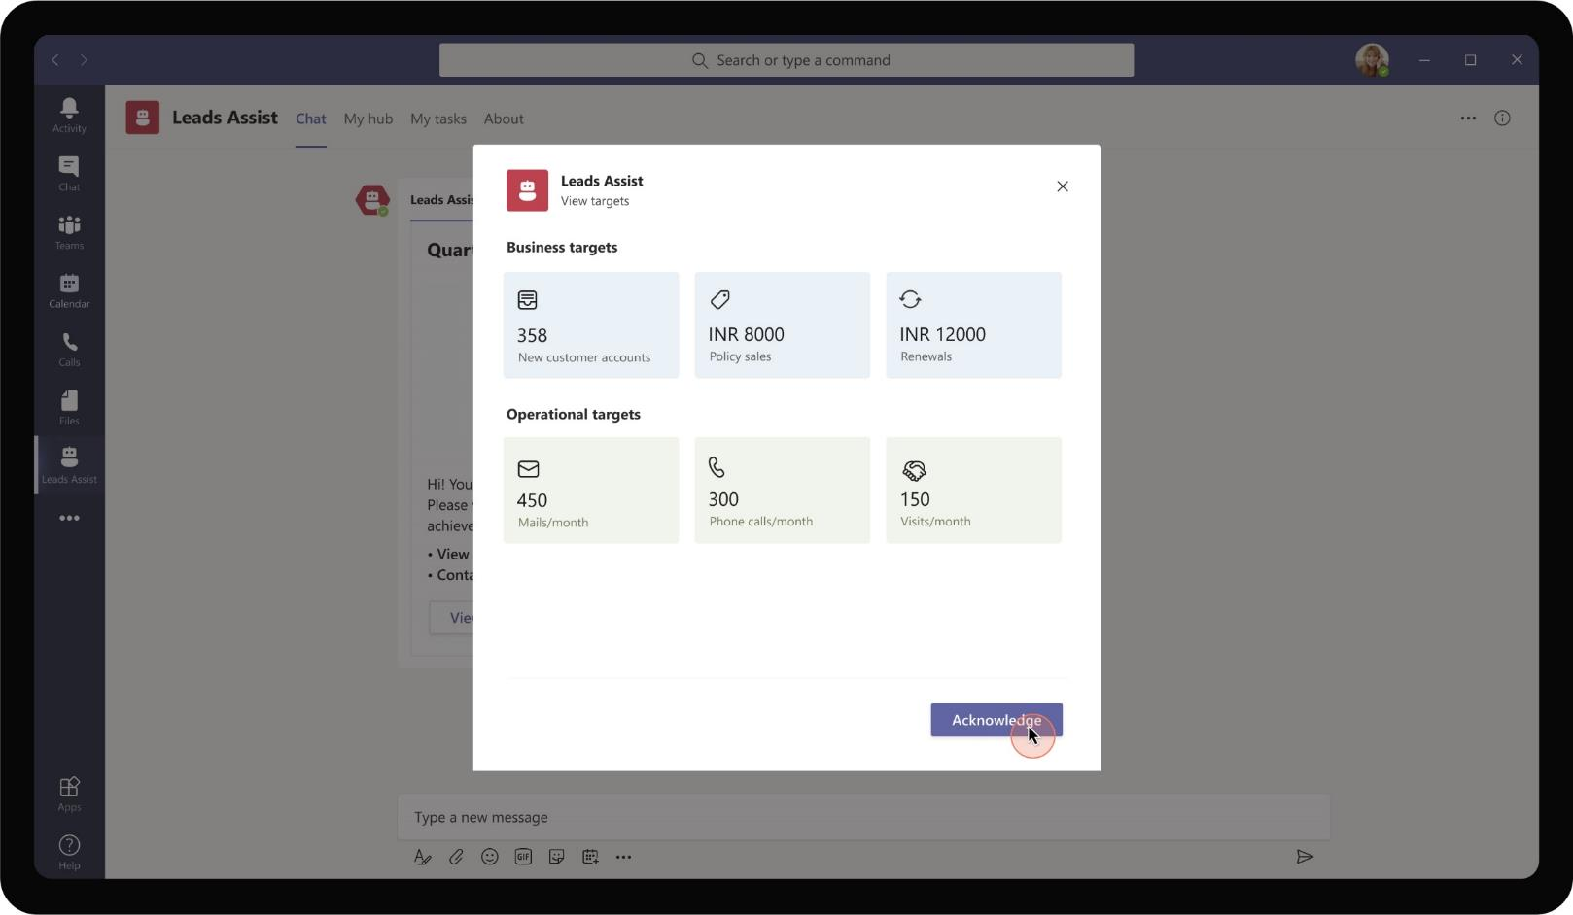
Banking & Financial Services – Lead Management System
Daniela reviews the targets assigned to her to confirm that it is in line with her expectations and achievable. She proceeds to acknowledge that she has viewed the targets

Slide 9

Banking & Financial Services – Lead Management System
As the targets provided for Daniela are achievable and Daniela has no further questions to discuss with manager, she proceeds to accept the target set for her.

Slide 10
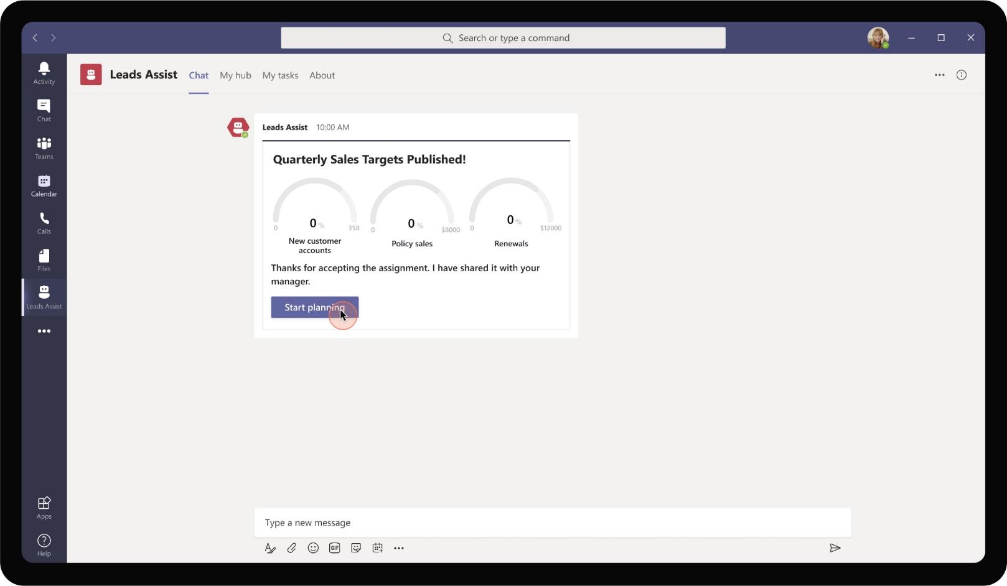
Banking & Financial Services – Lead Management System
Once accepted, the adaptive card refreshes to show a counter indicating Daniela’s progress towards her quarter goals. The app also prompts Daniela to start planning her strategy to achieve the targets

Slide 11
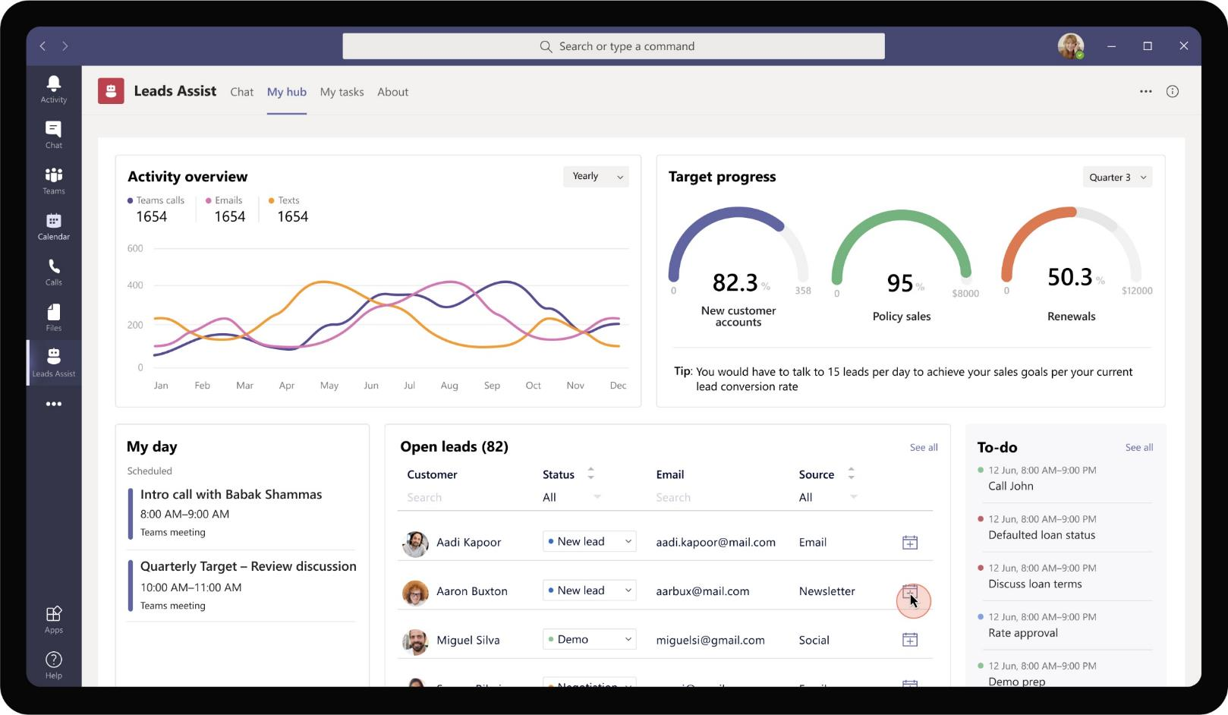
Banking & Financial Services – Lead Management System
Daniela is taken to her personal hub which shows her activities - # calls made, # emails sent to leads. It also shows her progress in previous quarters to help provide a retrospective view and plan her velocity. Daniela has the option to select a few leads to reach out during her day

Slide 12
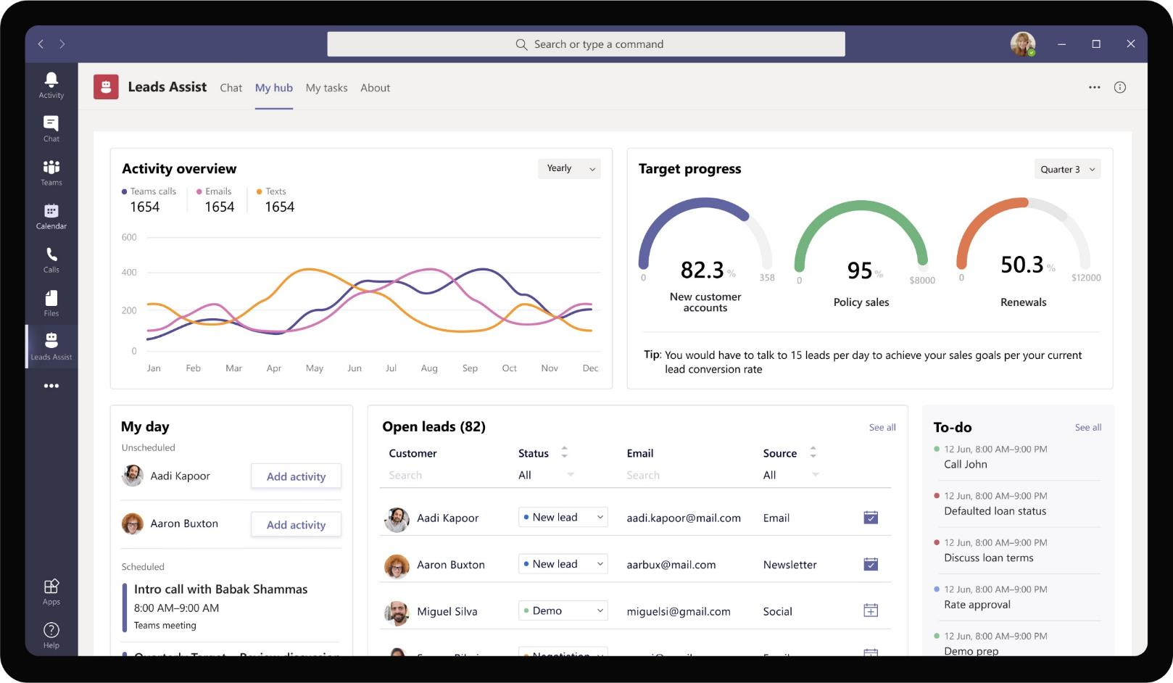
Banking & Financial Services – Lead Management System
As Daniela chooses the leads she wants to reach out to, it gets added automatically to her calendar and the app reminds her at regular intervals to make contact with the selected leads.

Slide 13
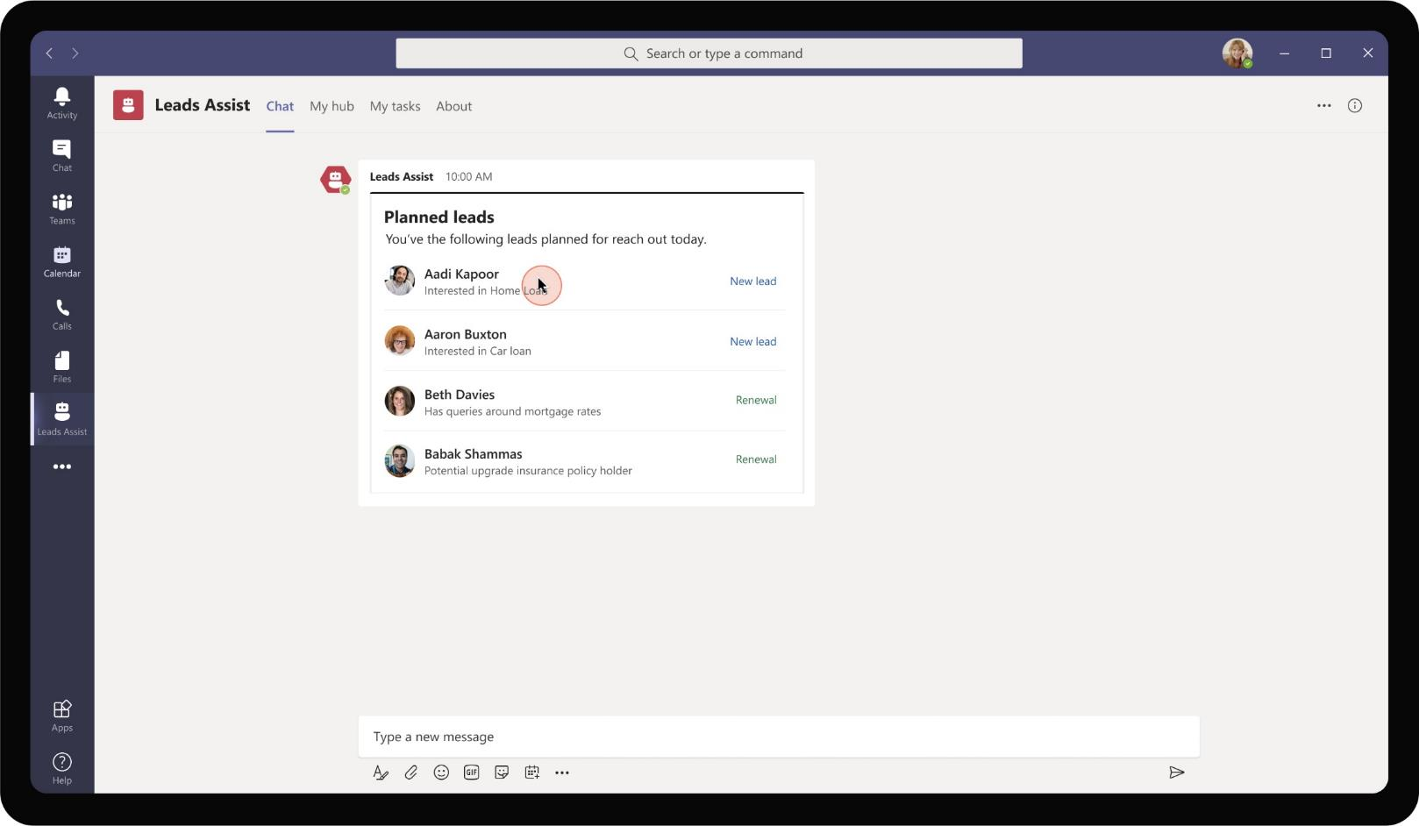
Banking & Financial Services – Lead Management System
As the app notifies Daniela of the leads, she clicks on the first lead to learn more about their profile and background to have a more informed conversation with the lead

Slide 14
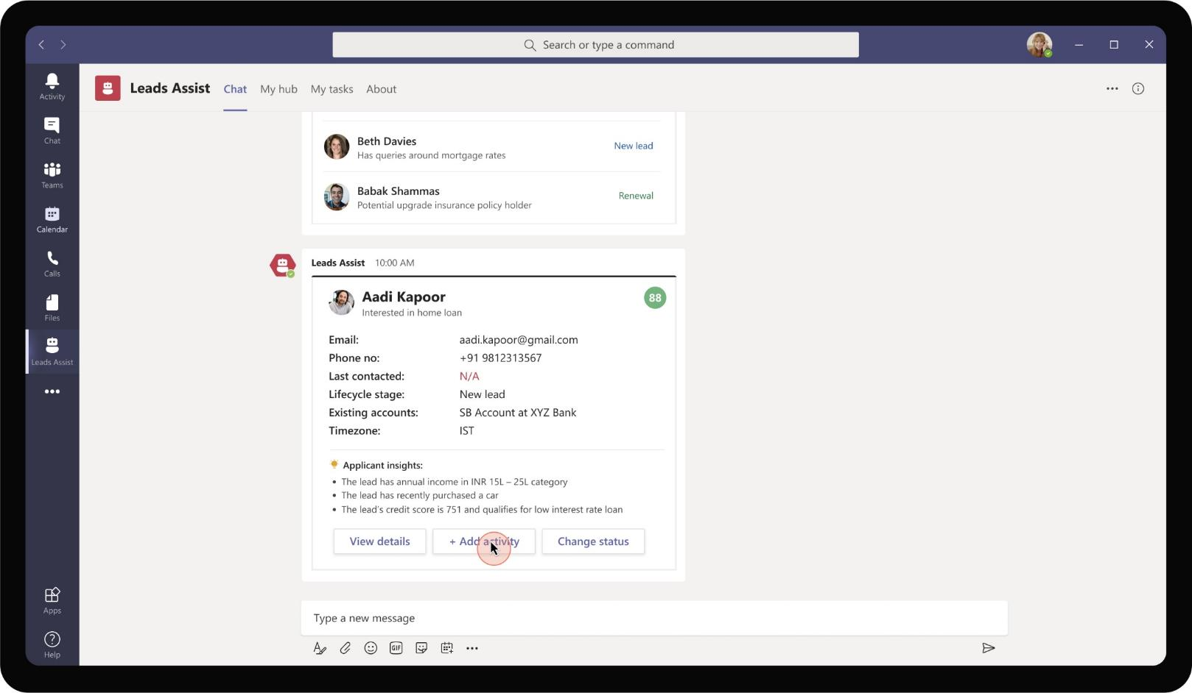
Banking & Financial Services – Lead Management System
An adaptive card shows up with basic information from CRM about the lead Aadi Kapoor. In addition, the app suggests insights into the preferences and demographics of the lead as recorded in the CRM. Daniela sees that the lead qualifies for a few loan offers

Slide 15
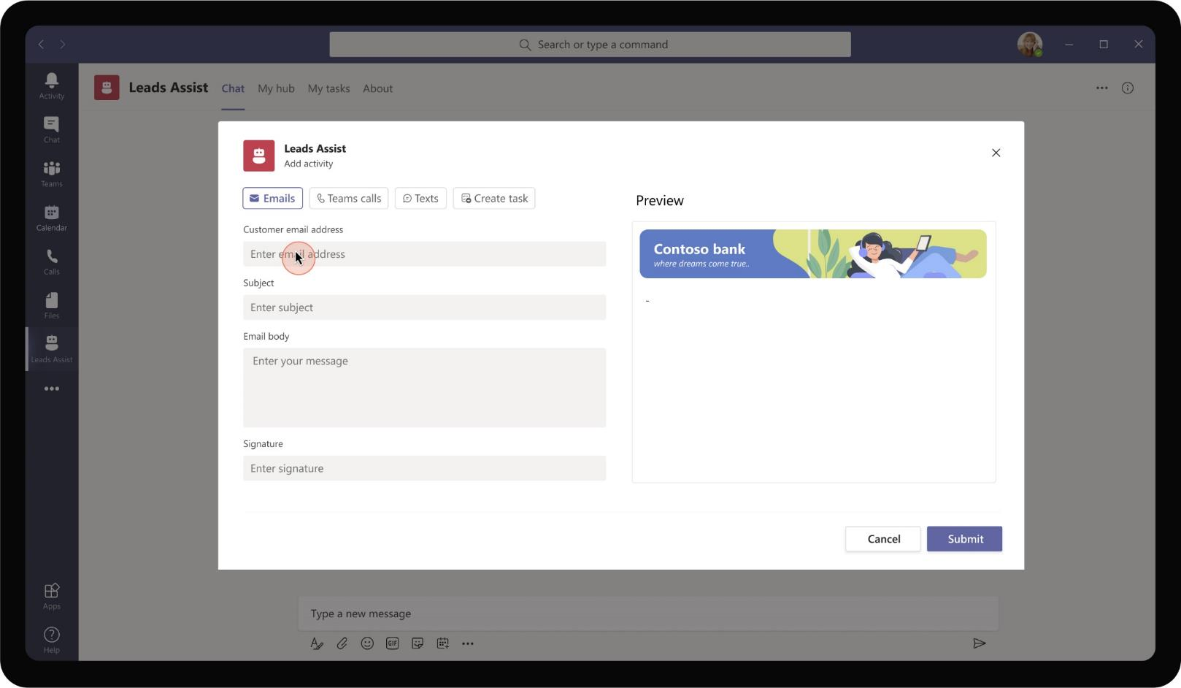
Banking & Financial Services – Lead Management System
Daniela reaches out to the lead initially via e-mail. The app provides her the ability to draft an email directly from Teams. It is pre-filled with letterhead and other relevant details that need to be sent out to all potential customers.

Slide 16
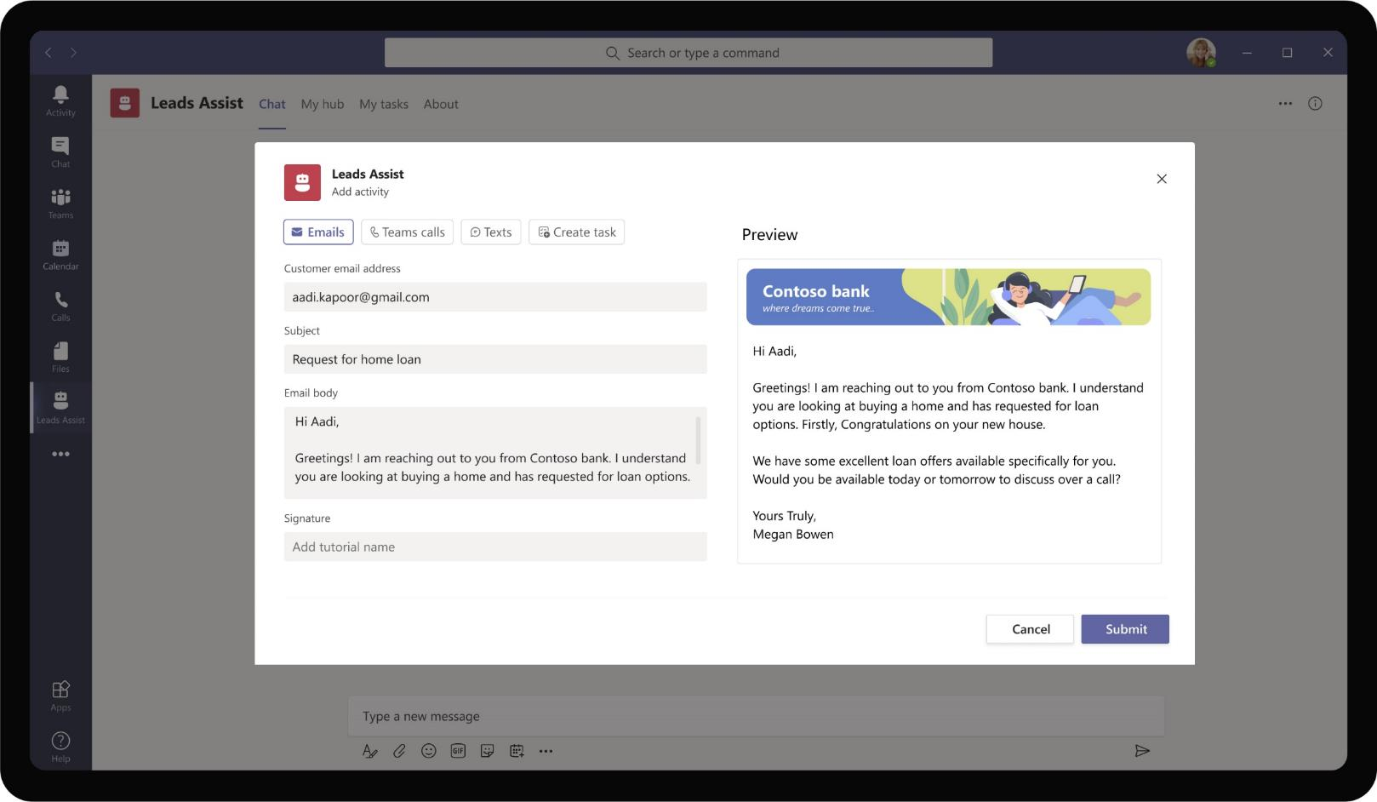
Banking & Financial Services – Lead Management System
Daniela Mandera
Daniela Mandera
Daniela gets to know from CRM information that Aadi is purchasing a house and is eligible for home loan offers as well. She proceeds to draft an e-mail to check Aadi’s interest in home loan options from Contoso bank

Slide 17
After a couple of days, Aadi Kapoor replies to the e-mail sent by Daniela enquiring about loan options and requests for a call.

Slide 18
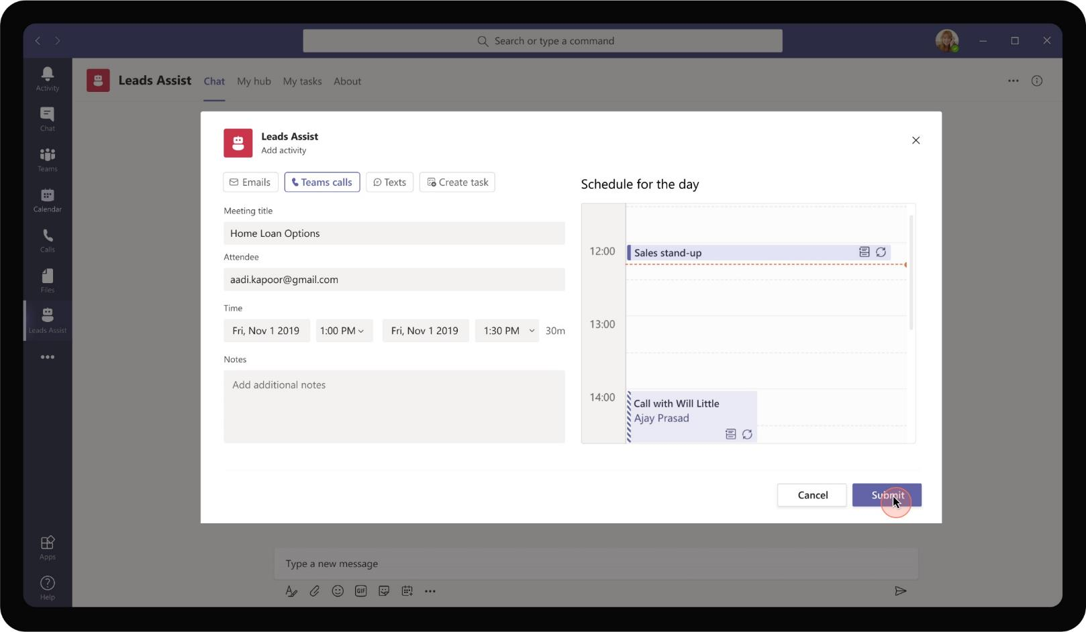
Banking & Financial Services – Lead Management System
Daniela uses the app to schedule a call with Aadi. The app provides flexibility to add additional attendees if required and suggests suitable time to schedule a meeting with the lead.

Slide 19
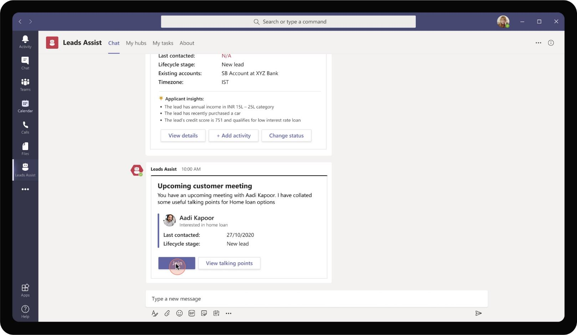
Banking & Financial Services – Lead Management System
At the scheduled date and time, the app proactively reminds the relationship manager to join the meeting and suggests some talking points as well for preparation.

Slide 20
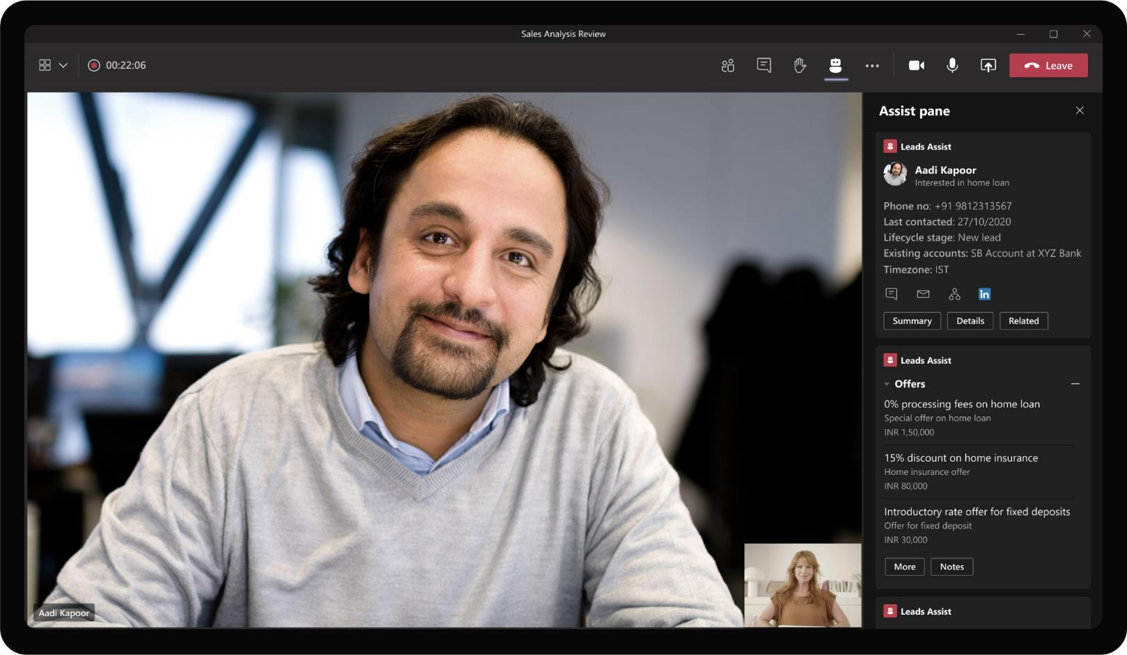
Banking & Financial Services – Lead Management System
Home Loan Options
As Daniela joins the call with the lead, the app shows basic information about the customer on the meeting side panel. It also brings up customized offers, discounts and talking points available for Aadi Kapoor

Slide 21
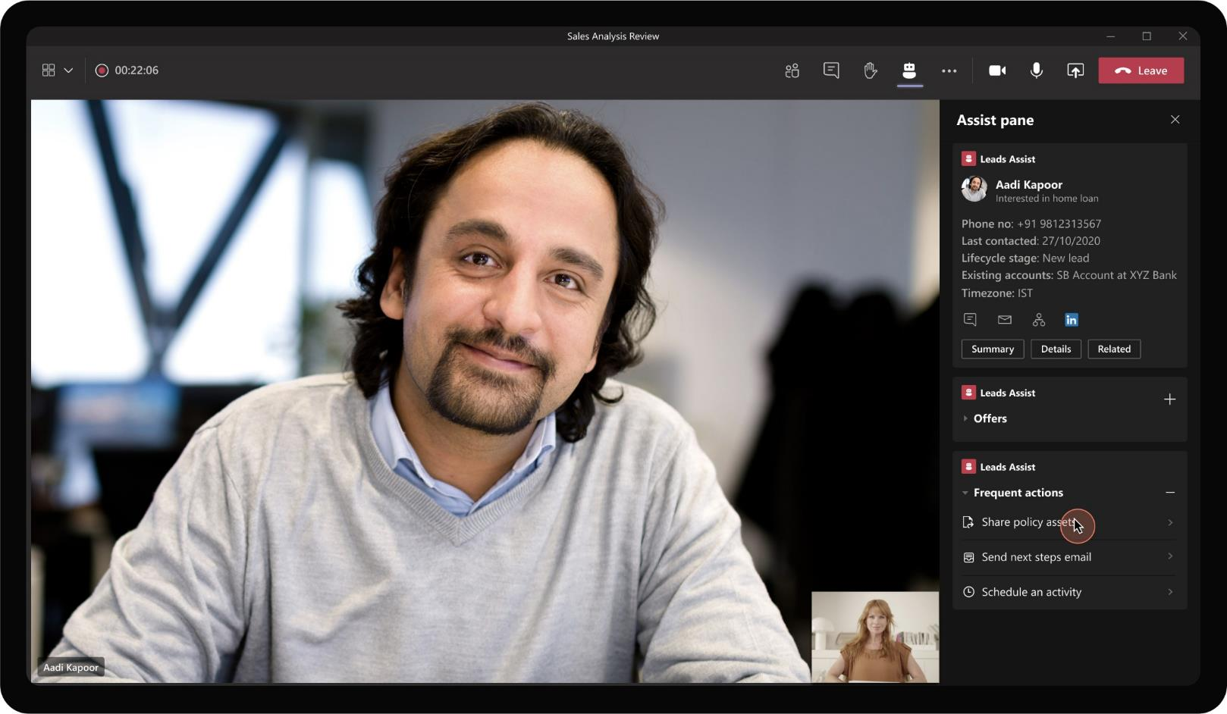
Banking & Financial Services – Lead Management System
Home Loan Options
Daniela can also use the side panel to perform frequent actions such as sharing of documents, e-mails to the lead while on the call. Daniela chooses to share an asset related to the home loan policy under discussion.

Slide 22
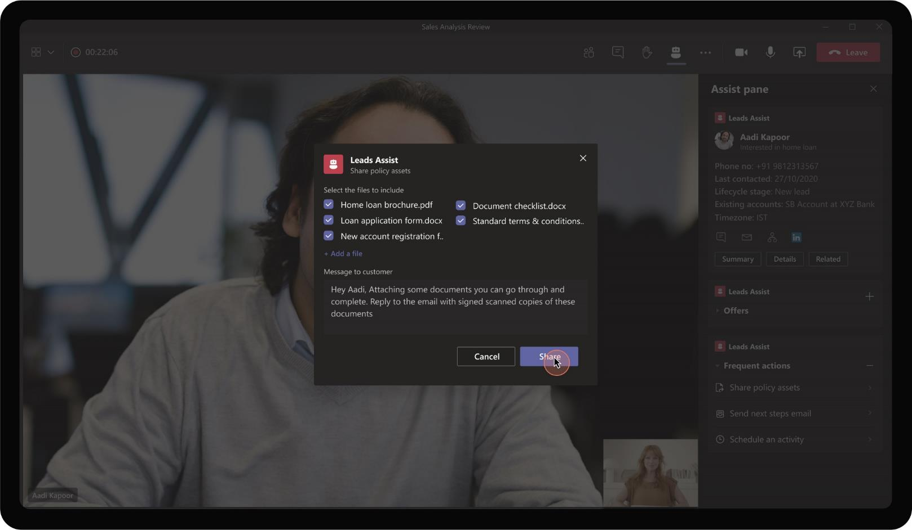
Banking & Financial Services – Lead Management System
The app prompts a dialog box for Daniela to view and choose the files to be shared with the lead. Optionally, Daniela can also add a note along with the message. On clicking ‘Share’ these files are sent as attachments in e-mail to Aadi Kapoor.

Slide 23
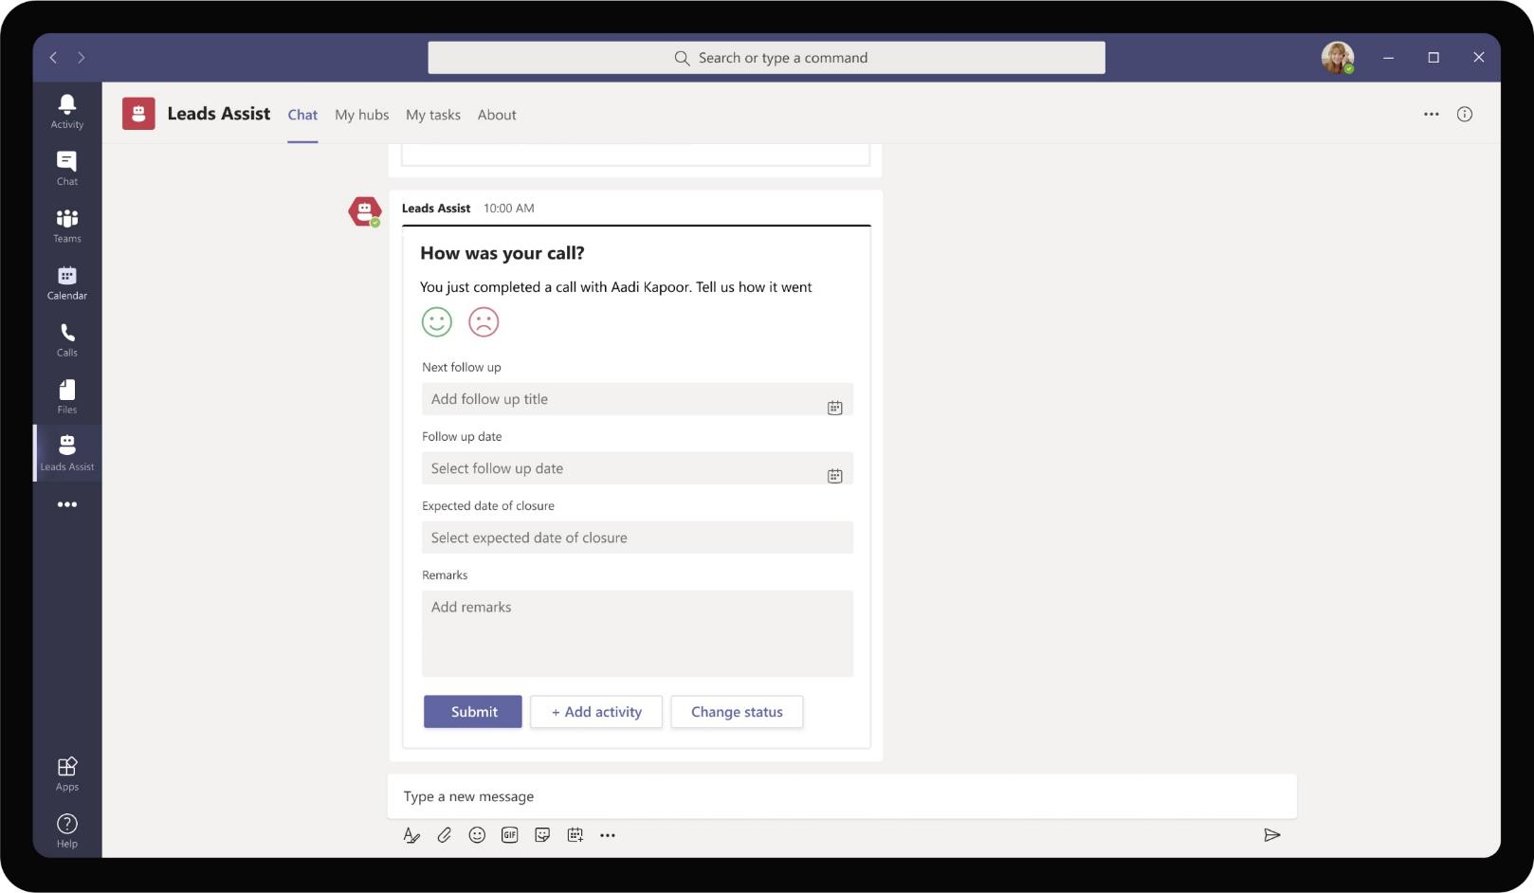
Banking & Financial Services – Lead Management System
Post the call with lead, Daniela is prompted to enter her experience speaking with the lead and document any follow-up activity that would be required.

Slide 24
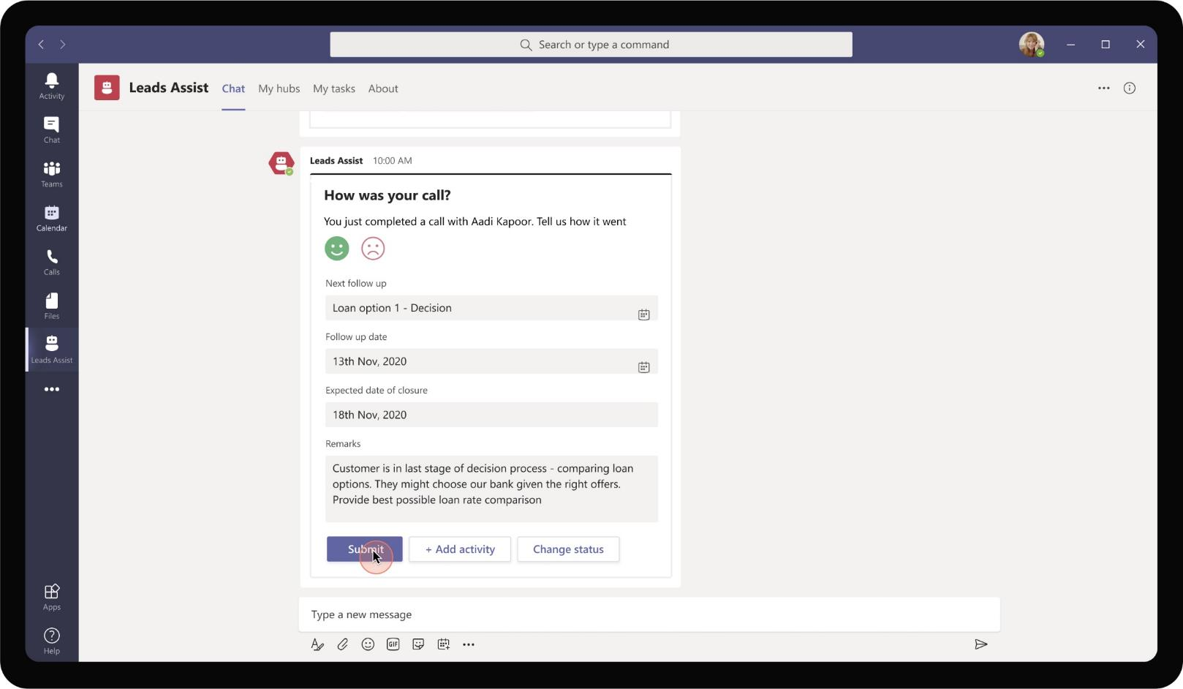
Banking & Financial Services – Lead Management System
Daniela makes a note that Aadi is in last stage of decision making process and would potentially choose Contoso’s loan offer given the right rate offered. This will be useful to keep in mind during follow-up calls

Slide 25
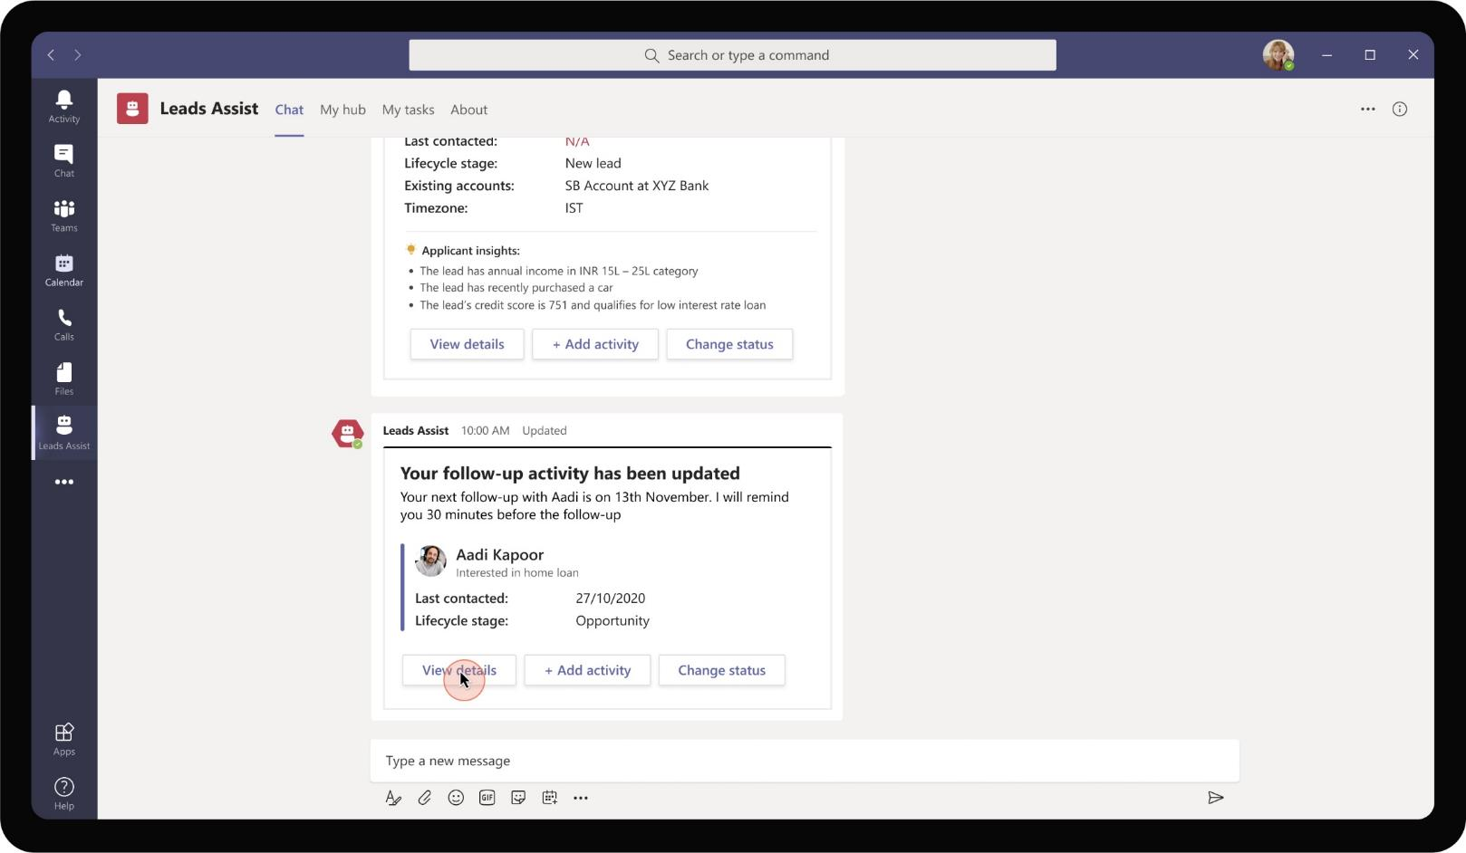
Banking & Financial Services – Lead Management System
The app makes a note of the experience and the follow-up activity. It will prompt Daniela to take action on the day of scheduled follow-up easing her life in tracking lead relationships.

Slide 26
Aadi Kapoor gets back to Daniela and agrees to proceed with Contoso’s loan offer. Daniela tracks Aadi’s win in the CRM and identifies other opportunities

Slide 27

Banking & Financial Services – Lead Management System
In order to track the lead status to completion, Daniela uses her personal dashboard view to click on the Opportunity stage of Aadi Kapoor.

Slide 28

Banking & Financial Services – Lead Management System
She proceeds to mark it as a won opportunity in the drop down that appears.

Slide 29
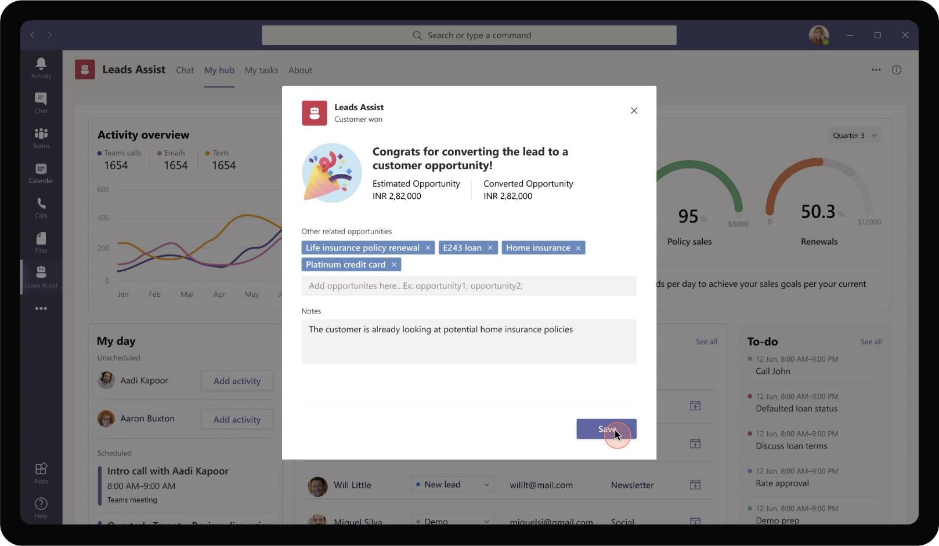
Banking & Financial Services – Lead Management System
As Daniela marks the opportunity as won, she is prompted to enter further details around the customer and cross-sell, up-sell opportunities present. This will be tracked in CRM by same / other departments.

Slide 30

Banking & Financial Services – Lead Management System
On marking ‘Customer won’, Daniela gets closer in achieving her sales targets successfully. Opportunity stage changes are recorded in CRM backend

Slide 31
Solution Highlights – Best Practices
Banking & Financial Services – Lead Management System
Key Solution Design Considerations
Platform Extension Points
User Experience
Personal Scoped App The app is completely personal scoped because target setting, progress towards the target are personal and not done in collaboration with other RMs.
Personal Tab – The tab is used for presenting the highly visual analytics of operational metrics, velocity information and filterable view of leads. Tab is required to show all this information in one hub with flexibility of UI elements.
Personal Bot – Personal bot is mainly used for notification, reminders and alerting users about lead management.
Apps in Meetings are used to surface relevant information needed by the RM in converting a lead. Meetings / Calls are a core component of RM’s day to day activities so meeting extensibility is a core component.
Task Modules are used primarily for adding an activity – sending e-mails, performing calls and adding reminders. These actions are means to an end (performing activity on a lead) and should be done within the flow
Card refreshes are used to update the card status instead of sending multiple different cards about the same request. This ensures that readability is easier, and app does not spam with multiple cards for updates.
List cards are used for providing a single consolidated view of leads with summary information around the lead. This provides a high level view which RMs can delve deep into on a per lead basis.
Proactive Messages are sent at scheduled time to remind RMs about upcoming calls with leads.
Graph API
The app utilizes Send Mail Graph API to create and send e-mails via signed-in user’s account to leads.
The app also uses Create Event Graph API to create Teams calls between leads and RMs and Calendar Graph APIs to read and show calendar events

Slide 32






Solution Architecture
Banking & Financial Services – Lead Management System
Azure Subscription
Graph API
AAD
External Systems
SSO and Reporting org
Calendar, emails
Bot / Task Module / ME
T&E Submission & Retrieval Forms
GET / POST Lead information
CRM Database
Employee
MS Teams
Bot Registration
Lead Assist
App Service
GET Lead wise Activity
GET Assets / Documents
Sales / Pitching Asset library
RM Activity Database

Slide 33
Business to Consumer Chat Center
Banking & Financial Services Book of Dreams

Slide 34
Scenario Vision
Relationship Manager
Context
Daniela is a relationship manager (RM) at Contoso Banking. She is part of a team that covers personal, home and car loan products for customers.
As part of her job responsibilities, Daniela is required to handle customer inquiries about products assigned to her. Leads from these inquiries are expected to be converted to customer opportunities contributing to her targets.
Current State
Customers typically reach out to Contoso banking RMs in the form provided in the website. All requests are sent as e-mails to a common mail box
The monitored mail box is triaged daily and assigned to Daniela based on the type of query.
Daniela respond over e-mails for all queries received and waits until the customer replies next. Live chat is not a supported option
All conversations history and customer information should be manually read and updated in the CRM by Daniela regularly
Handling more than one customer at a time becomes increasingly challenging due to multiple e-mail threads.
The RM has to manually prepare notes, talking points during calls with customer by going through customer info in CRM and past email threads.
Future State
As soon as a customer requests information on an inquiry, a chat request is initiated and assigned to Daniela
Daniela accepts the chat and starts interacting with the customer from within Teams. Triaging happens automatically based on type of query
Live chat is supported using the app and it also supports chatting with multiple customers in parallel
Conversations with each customer is automatically tracked and recorded in CRM. It also provides basic info & talk track for the RM
The app also provides option to schedule meetings with the customer instantly and provides in meeting experiences to the RM
During the meeting, the app provides talk track with customized offers and discounts for Daniela.
- Points of Friction

Slide 35
Daniela Mandera, Banking Relationship Manager
Daniela is a relationship manager at Contoso Banking. She frequently handles inquiries from customers regarding loan options. She works with the leads to clarify their concerns and win customer sales.

Slide 36
Megan Bowen, a potential customer, has reached out to Customer support service in the bank’s website with a query regarding car loans

Slide 37
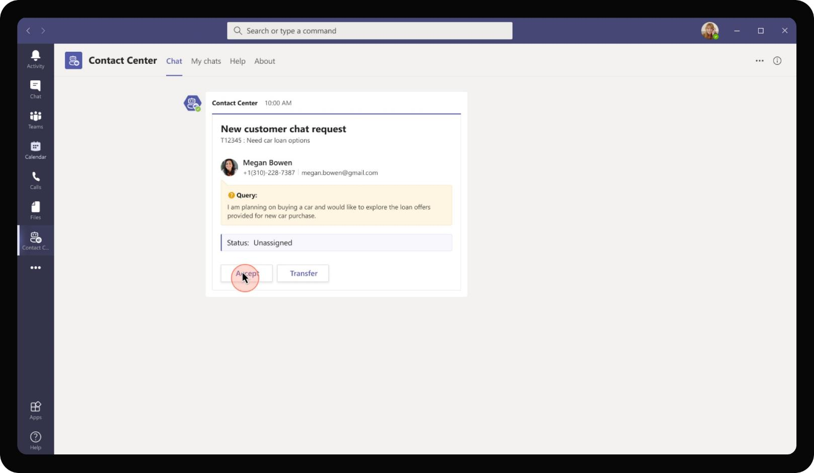
Banking & Financial Services – B2C Chat Center
As Megan initiates a chat request to a relationship manager, the app checks for the type of query, available RMs at that time and sends an adaptive card for Daniela as she is available to handle the query. The card provides the query that Megan has raised for context.

Slide 38
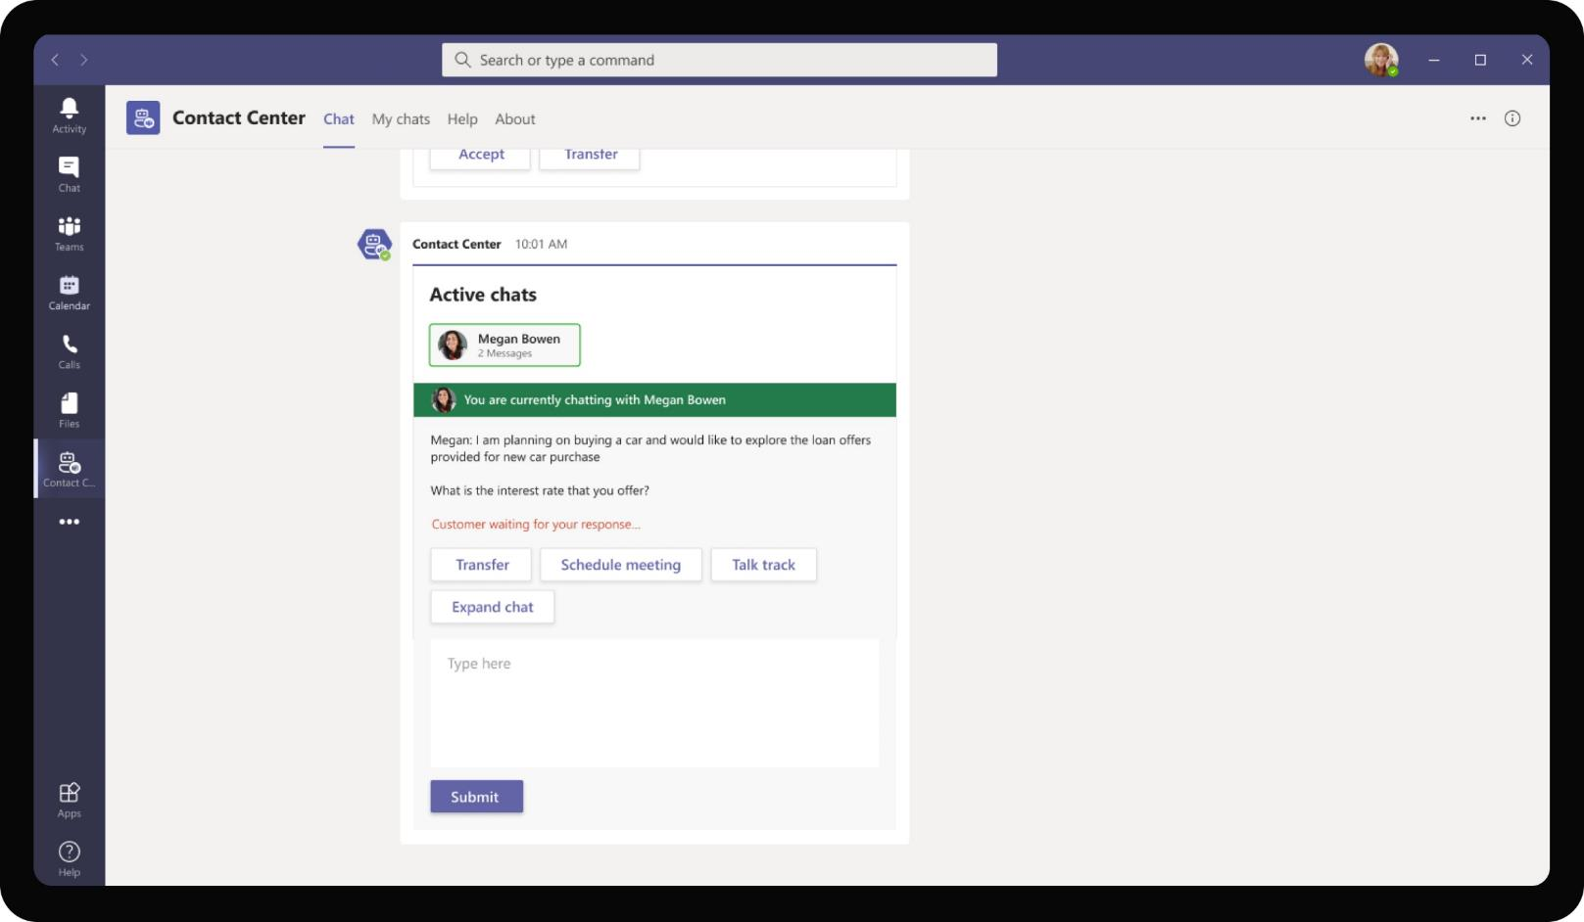

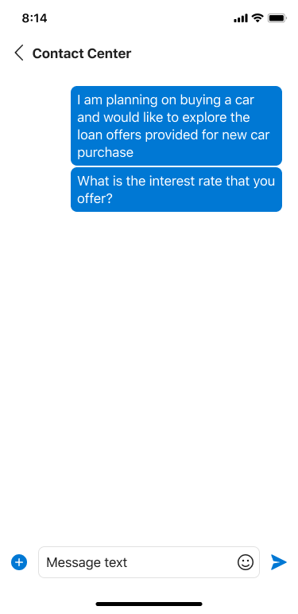
Banking & Financial Services – B2C Chat Center
Contoso Bank
On accepting the request, a new card is posted in the chat clearly indicating the customer that Daniela is currently chatting with. The card has a text box where Daniela can type responses to the query and initiate live chat with Megan.

Slide 39
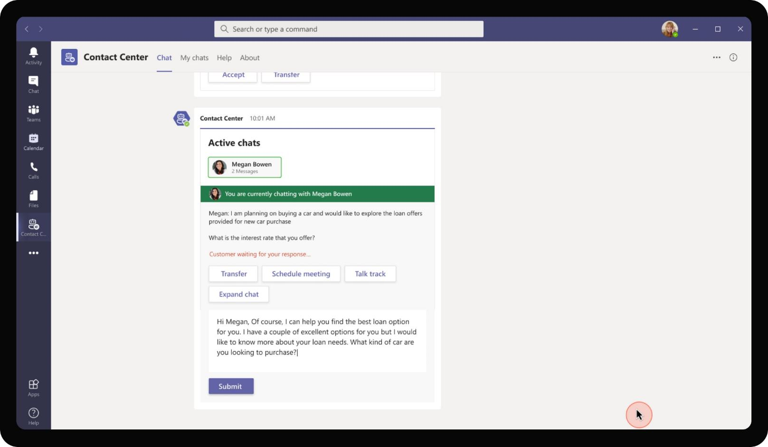

Banking & Financial Services – B2C Chat Center
Contoso Bank
Daniela proceeds to write a response to Megan in the text box. She asks a follow up question to Megan to narrow down the loan options that would fit Megan’s needs.

Slide 40

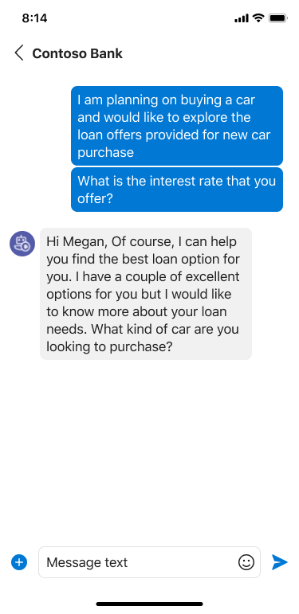
Banking & Financial Services – B2C Chat Center
Contoso Bank
On clicking submit, the message gets sent to Megan on the web chat on Contoso’s site. Megan sees the message from Daniela on her mobile as a response from a bot chat.

Slide 41
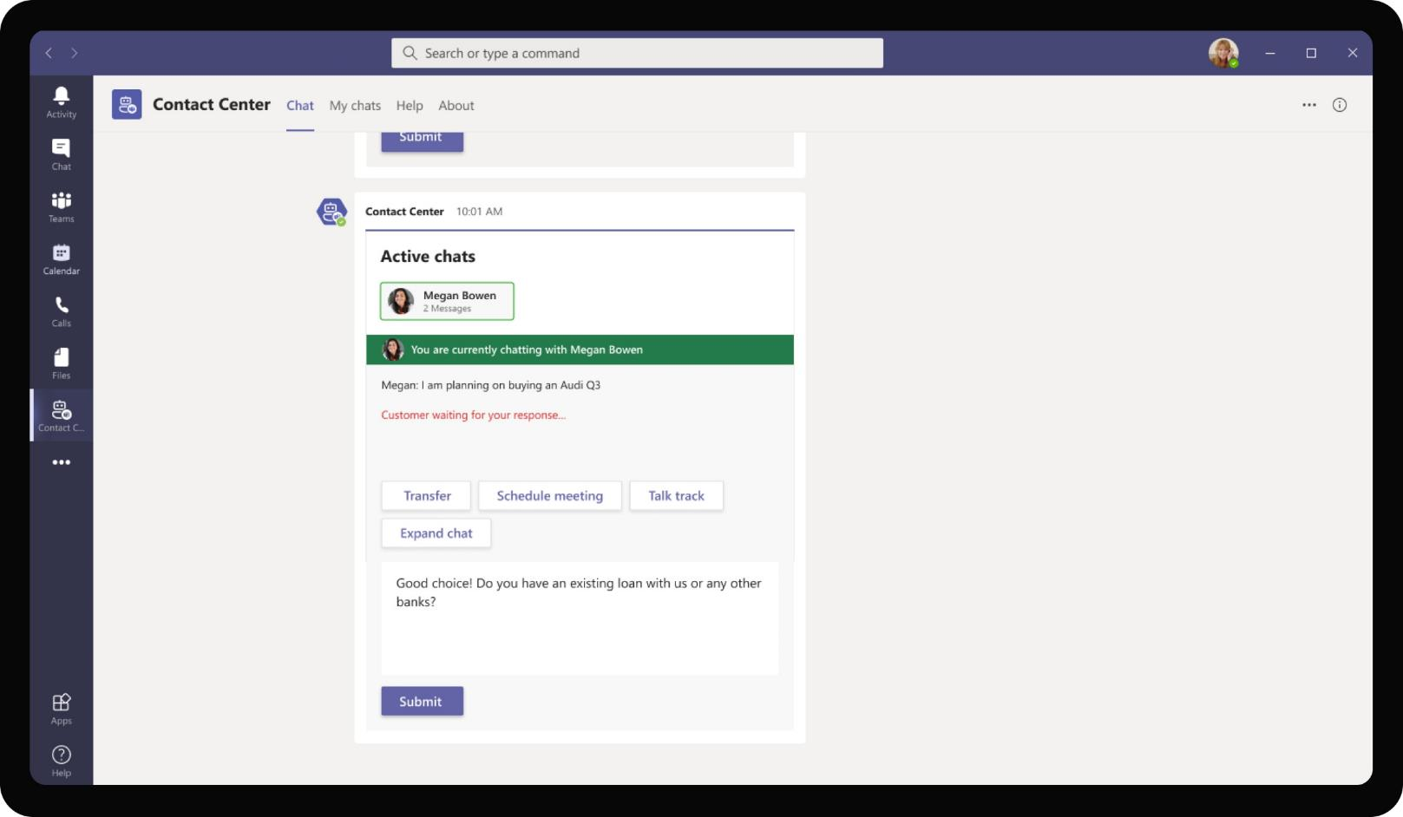
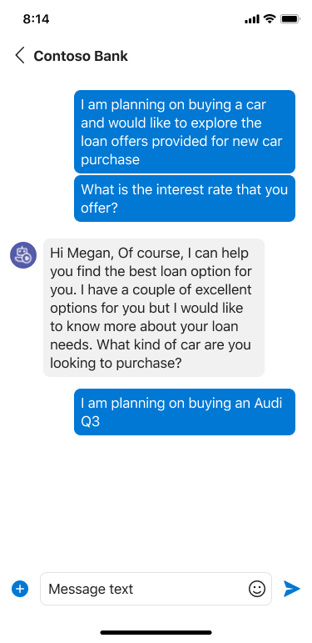
Banking & Financial Services – B2C Chat Center
Contoso Bank
As Megan types a reply from her mobile on the web based bot, the response is updated on the adaptive card for Daniela to view. Daniela proceeds to type a response on the text box at the bottom.

Slide 42
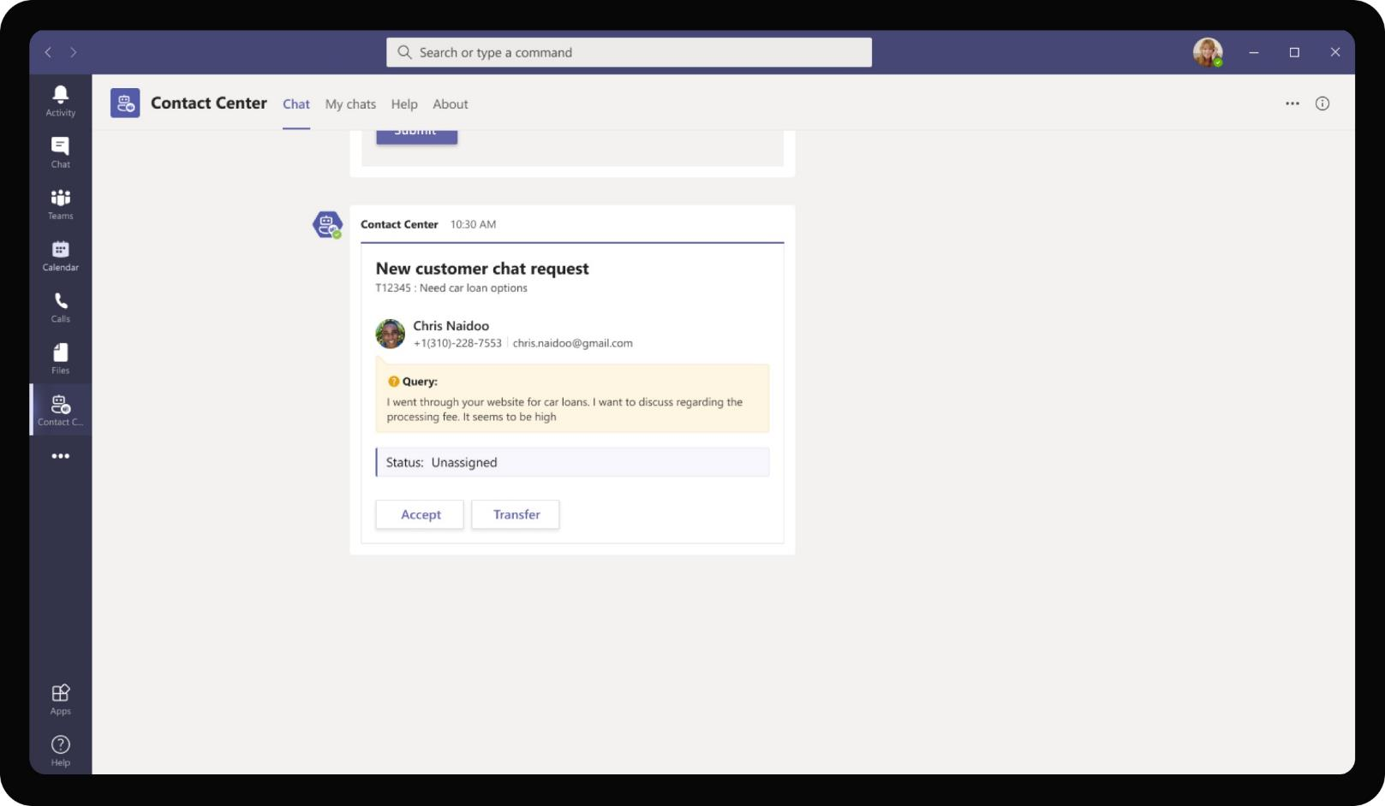
Banking & Financial Services – B2C Chat Center
While Daniela is speaking to Megan regarding a card loan options, another potential customer, Chris Naidoo also wants to clarify a few questions around car loan fees and submits a chat request on Contoso Banking’s mobile app.

Slide 43
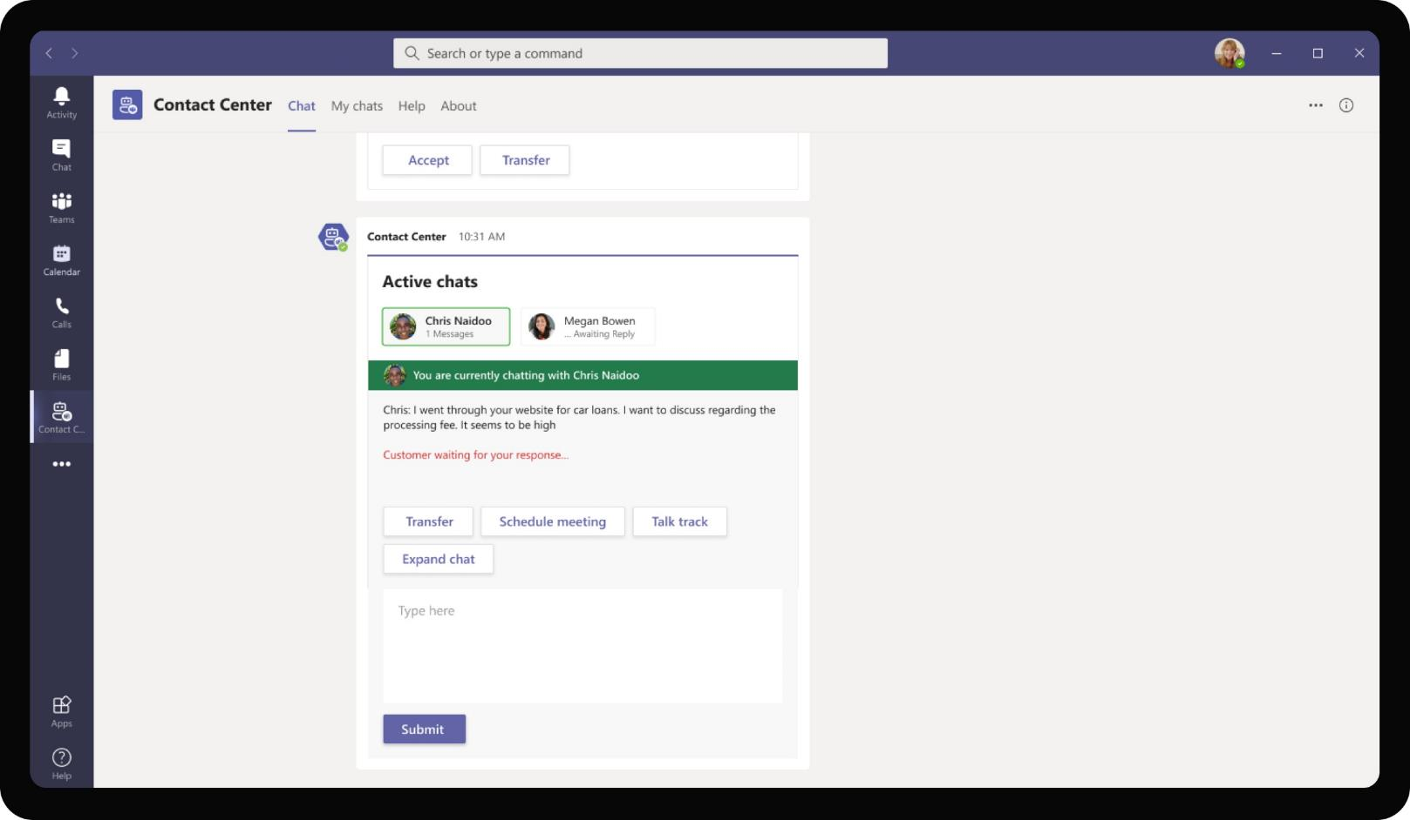
Banking & Financial Services – B2C Chat Center
Since Daniela is available to support more customers in parallel, she accepts the chat request. An adaptive card appears which shows both Megan and Chris’s chat history, while clearly highlighting the selected customer for chatting.

Slide 44
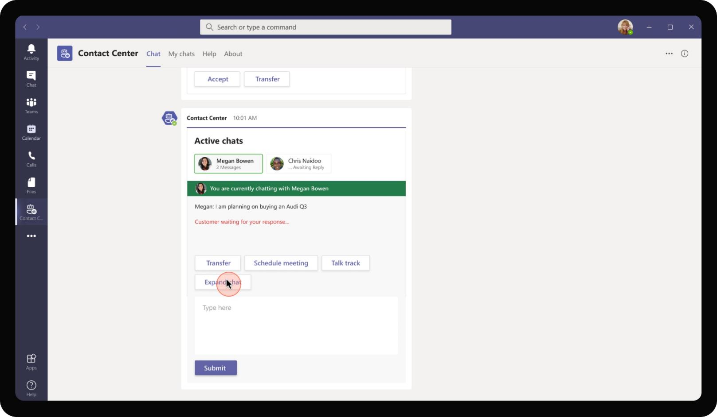
Banking & Financial Services – B2C Chat Center
Daniela can switch easily between chatting with Chris and Megan by clicking on their respective buttons. Any chat messages sent by Daniela will be sent to the currently selected customer.

Slide 45
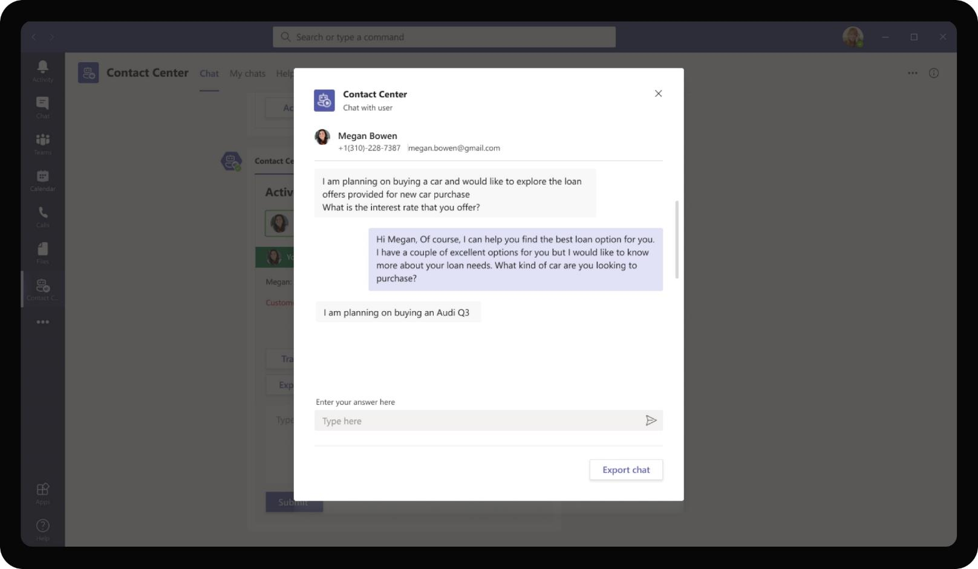
Banking & Financial Services – B2C Chat Center
As chat conversations go longer, Daniela can expand chat to open a task module with the entire chat history with the customer. Daniela can also use the text box in this view to continue chatting with Megan.

Slide 46
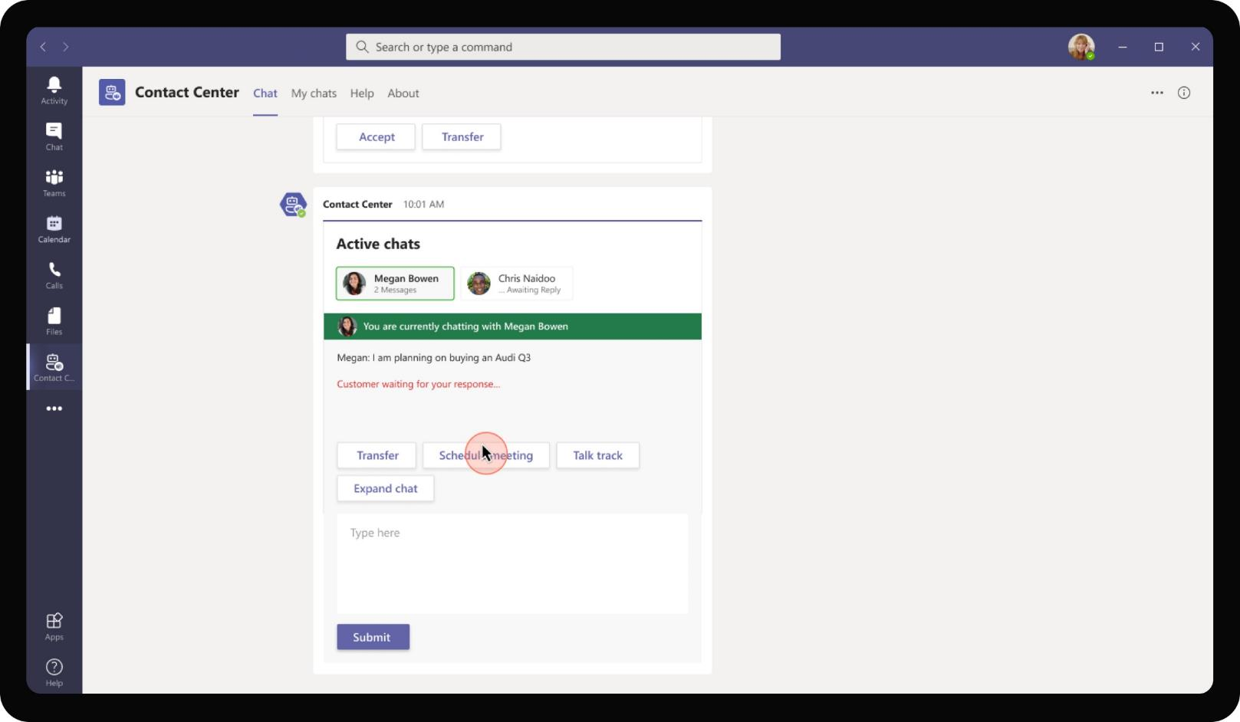
Banking & Financial Services – B2C Chat Center
Once Daniela gets enough information from the customer from chat, if the customer wishes, Daniela can continue rest of the discussions over a call where she can share more information with the customer.

Slide 47
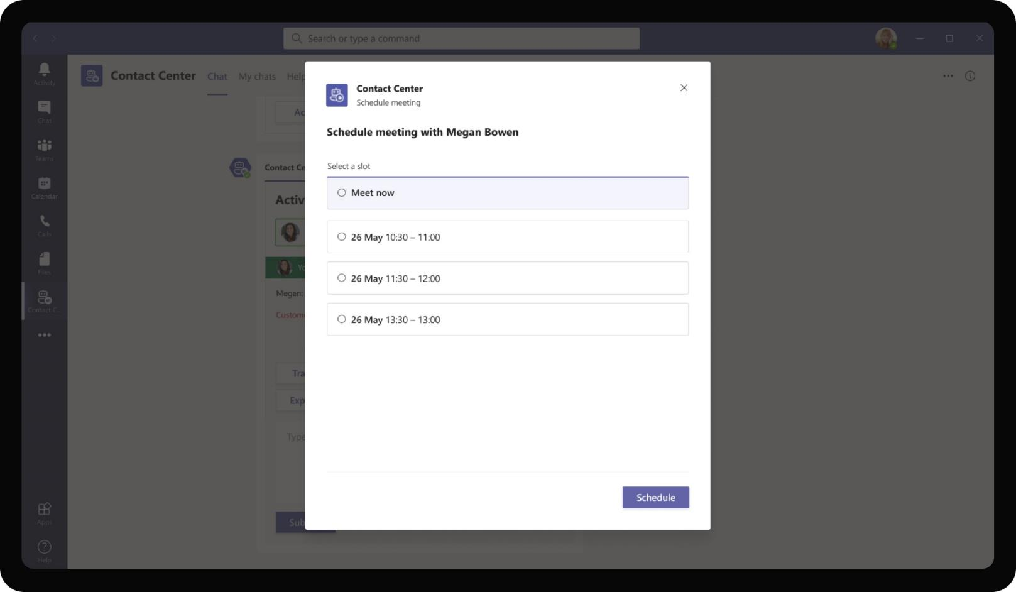
Banking & Financial Services – B2C Chat Center
The app proposes a few slots for scheduling the meeting as per availability in Daniela’s calendar and preferences provided by Megan, if any.

Slide 48
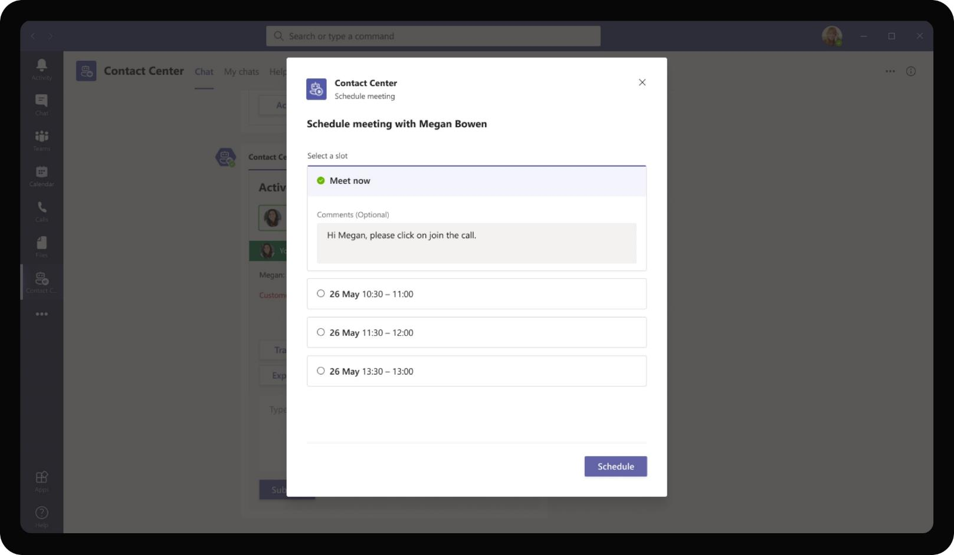
Banking & Financial Services – B2C Chat Center
Daniela may also choose to meet immediately with the customer. In this case, since the customer Megan wants an immediate response and clarification, Daniela schedules a call.

Slide 49
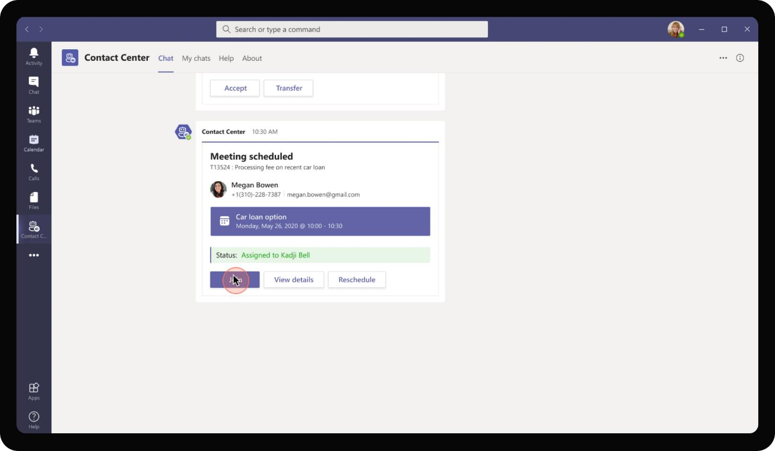
Banking & Financial Services – B2C Chat Center
The app schedules a meeting with Megan a

Slide 50
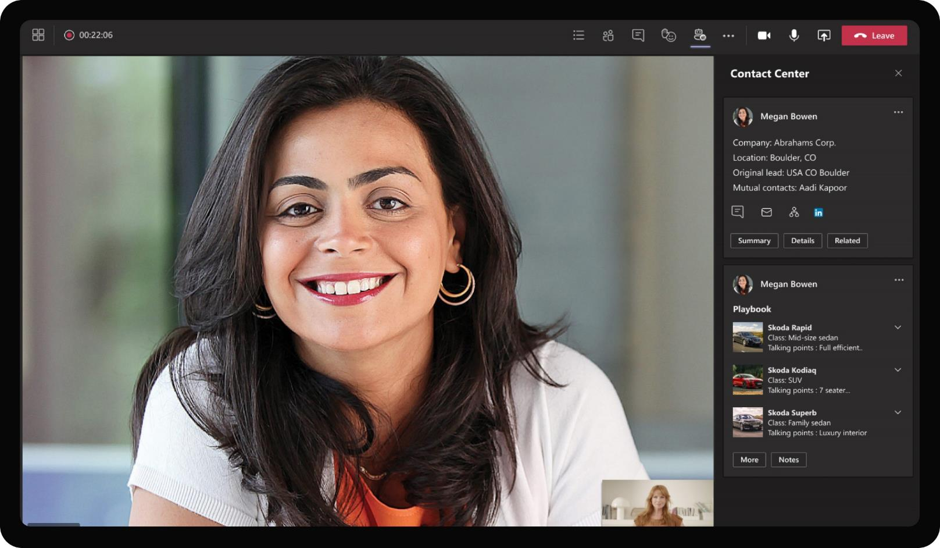
Banking & Financial Services – B2C Chat Center
During the call, the app provides basic information about the customer to Daniela to help her provide loan offers that will be relevant to the customer. In addition, it also shows loan offers available for various categories of cars for Daniela to refer during pitching.

Slide 51
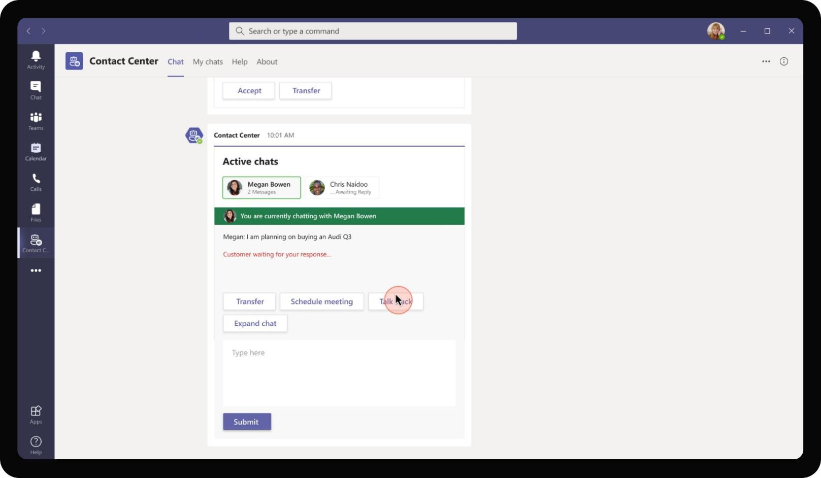
Banking & Financial Services – B2C Chat Center
Even outside calls, the app provides curated and customized talk track depending on the type of queries that come from customers. Daniela can refer to the talk track while chatting with customers.

Slide 52
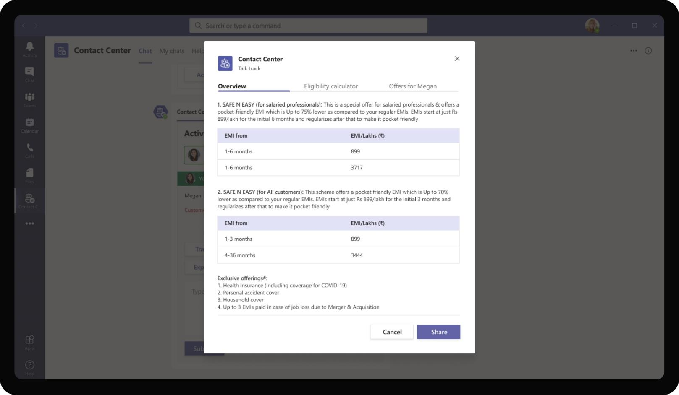
Banking & Financial Services – B2C Chat Center
Clicking on the talk track opens a task module with overview of various loan options available for the particular customer. Daniela can pick and choose that best matches the customer need.

Slide 53
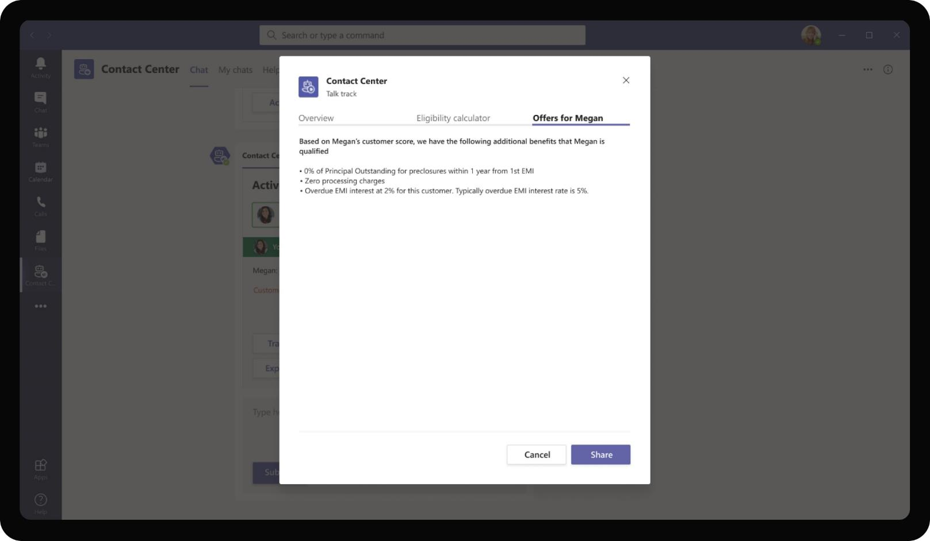
Banking & Financial Services – B2C Chat Center
If there are specific offers, discounts that the customer qualifies for, the app also provides Daniela with that information. This allows Daniela to have a more personalized conversation with Megan.

Slide 54
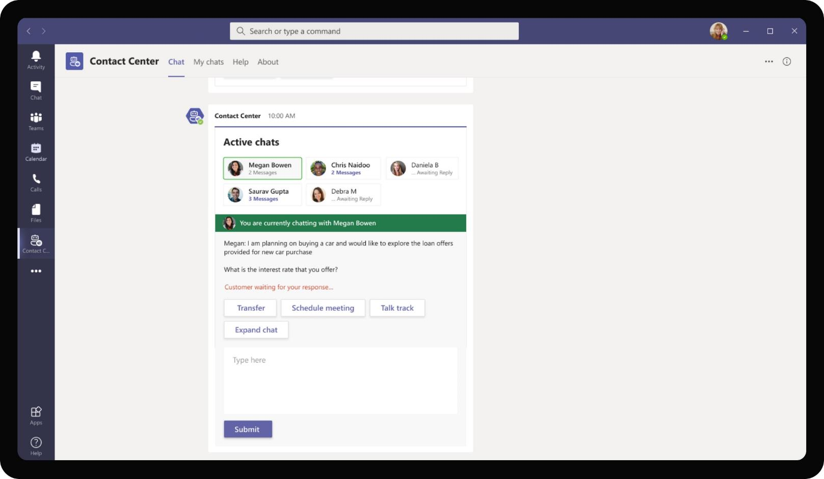
Banking & Financial Services – B2C Chat Center
Daniela can have up to 5 parallel conversations with different customers at a time using the app. The card updates to show unread messages for each customer chat allowing Daniela to switch to customers who are waiting for responses.

Slide 55
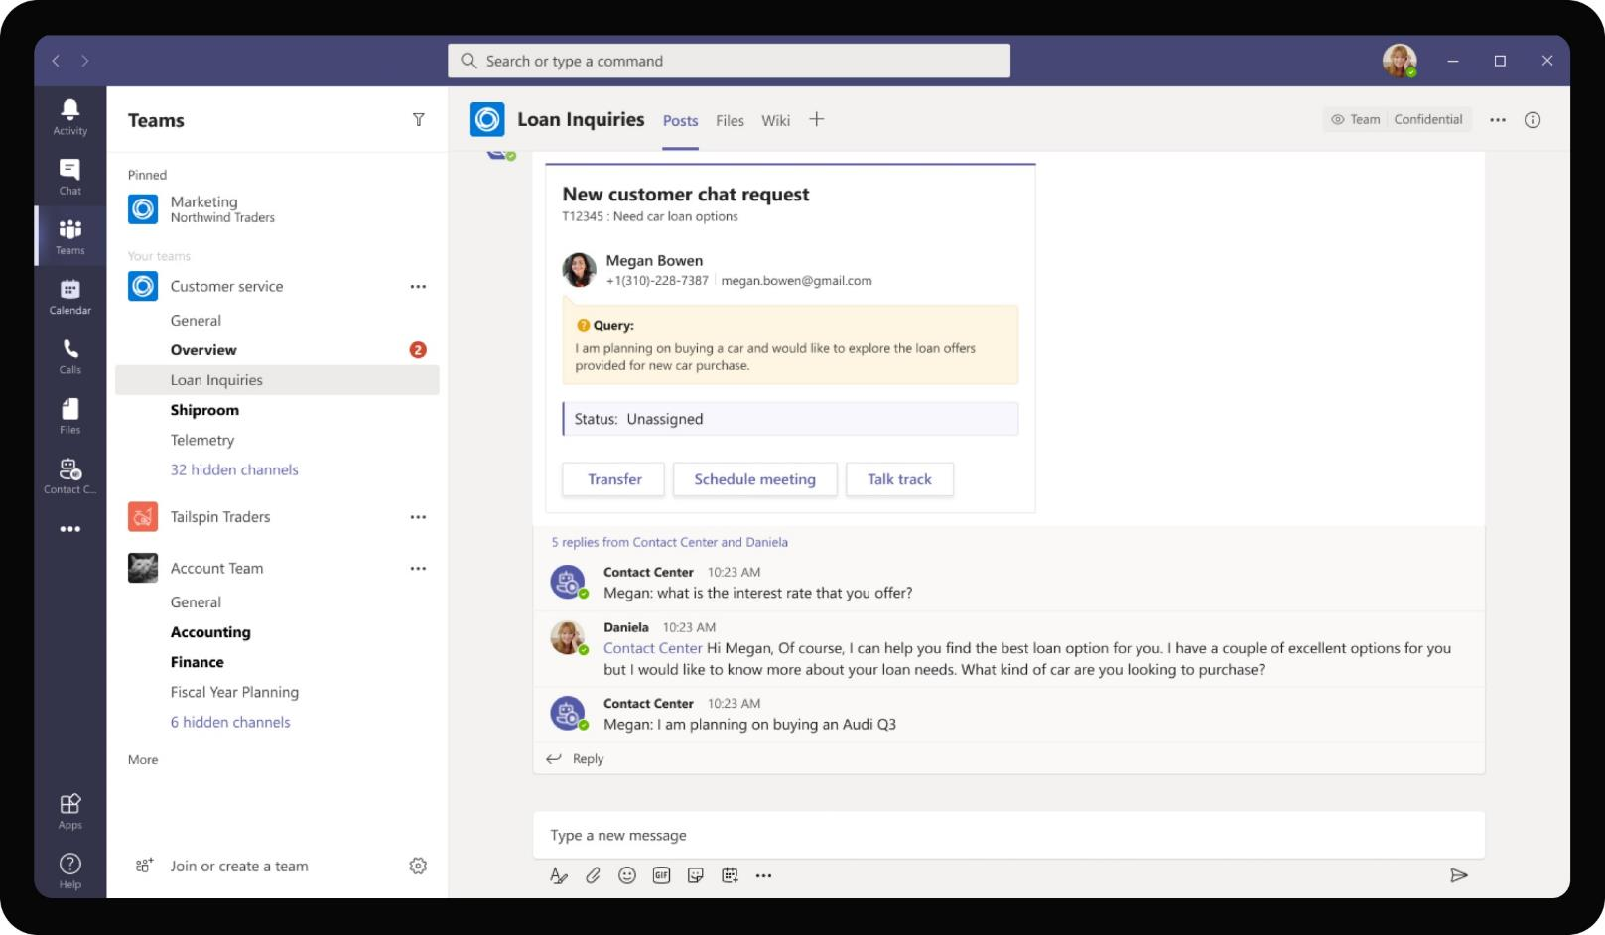
Banking & Financial Services – B2C Chat Center
Alternatively, the app can also be configured to work in channel scope where the customer conversations are visible for all RMs. RMs can collaborate to provide responses to open chat requests to any customer which is key during training phases.

Slide 56
Solution Highlights – Best Practices
Banking & Financial Services – B2C Chat Center
Key Solution Design Considerations
Platform Extension Points
User Experience
Personal Scoped App The app is defined to be predominantly personal scoped app with a bot to maintain privacy.
Personal Bot – Personal bot acts as a bridge between the RM on Teams and the customer on a client platform such as client mobile app / Messenger or other chat platforms.
The bot makes use of Bot Framework Channels to connect two parties interacting via two different channels. Microsoft Bot Framework supports interworking of multiple channels
Channel Scope (Optional): The last screen also represents a possible approach of implementing the RM <-> customer chat experience in channel scope as threaded messages. Visual complexity in adaptive card is lower as channels allow for threaded messages. However, all customer conversations are visible to all RMs and members of the Team / Channel.
Proactive Messages are sent to RMs whenever a customer initiates a chat request to speak to an RM
Card refreshes are used extensively to refresh same card when a new customer reply comes through or after an RM accepts an additional chat request. Since conversations are going to be multi-turn and between multiple customers at a time, it is imperative that the RM doesn’t get spammed with multiple cards for each reply.
Meeting Extensibility plays a key role when a text chat gets escalated into a Teams call for further information. With the app showing information right on meeting side panel, RM is empowered to provide accurate and relevant info instantly to customers.
Graph API
The app uses Create Event Graph API to create Teams calls between leads and RMs and Calendar Graph APIs to read and show calendar events
App makes use of Presence Graph API to assign incoming chat requests to RMs who are available at the time of request.

Slide 57




Solution Architecture
Banking & Financial Services – B2C Chat Center
Azure Subscription
Presence API
Join Call
MS Teams
Bot / Task Module / ME
Request – RM Assignment Parameters
Relationship Manager
MS Teams
Bot Registration
B2C Chat
VC Requester
GET Guides, documents
GET req info, customer profile, loyalty info
Azure Cognitive Services
Website / Consumer App
POST chat request
Conversations in Azure Table Storage
External Systems
Knowledge management
Repository
CRM

Slide 58
Approval Assistant
Banking & Financial Services Book of Dreams

Slide 59

Scenario Vision
Employee
Context
Daniela, a relationship manager at Contoso Banking is handling the creation of marketing asset for a discount flyer that is scheduled for distribution to customers announcing new year offers
Daniela needs to get approval from various stakeholders in her branch before she includes the flyer in the marketing communication.
Current State
Daniela sends draft of the flyer as an email attachment to each stakeholder separately. She avoids sending a group e-mail so as to not spam everyone in the mail thread in case there are replies from approvers
One of the approvers approves the document directly and sends the approval as a message over e-mail. Daniela notes the approvals in a separate excel list
Daniela also receives comments from a couple approvers to make a few modifications on the file. She makes the changes and sends a reply email for all approvers again walking through each modification and context
Daniela doesn’t hear from the approvers, so she sends a reminder e-mail again to her approvers
Once all approvers have provided approvals, Daniela confirms the approval and sends the final document to all.
She maintains a record of approved versions separately
All approvers go through multiple separate e-mail threads which quickly becomes cumbersome when 10+ approval requests come per day
Future State
Daniela uses Approve Assist app to submit an approval request for either multi level approvals or horizontal, concurrent approval requirements. While approval is submitted once, it tracks approval for each approver separately.
All approvers get notified of submitted approval request on the Teams app. As approvals come through, the app keeps track of pending and completed approvals leaving Daniela to focus on actual work
Reviewers can provide comments on the app directly which is available for other reviewers too without spamming them with messages.
Updated file with modifications can be added to same approval request by Daniela reducing e-mail threads and spamming approvers
Once all approvers have provided approvals, the final document is available for exporting as a PDF to all.
Old approvals are automatically maintained for all stakeholders for downloading at any point of time in the future
All approvals maintain an audit log which clearly shows the progress on approvals
- Points of Friction

Slide 60
Daniela Mandera, Relationship Manager
Daniela is a relationship manager at Contoso Banking. She handles customer inquiries, internal administration. She frequently creates customer facing assets, marketing flyers which are then distributed to customers

Slide 61
Daniela is tasked with designing a flyer for Contoso customers announcing them about new loan offers, rate discounts

Slide 62
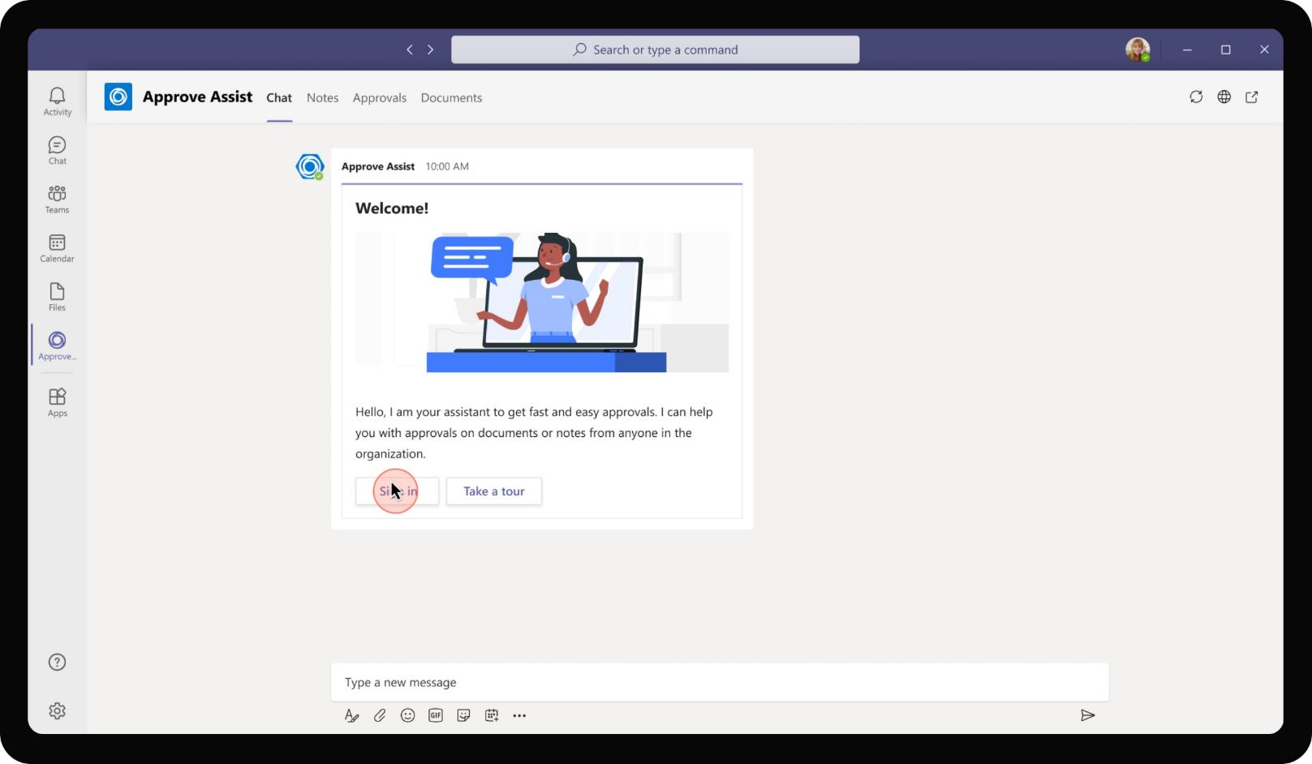
Banking & Financial Services – Approval Assistant
As Daniela adds the Teams app, she is welcomed with a message walking her through how the app can help her find information inside the organization and prompts her to sign in to make use of approvals

Slide 63
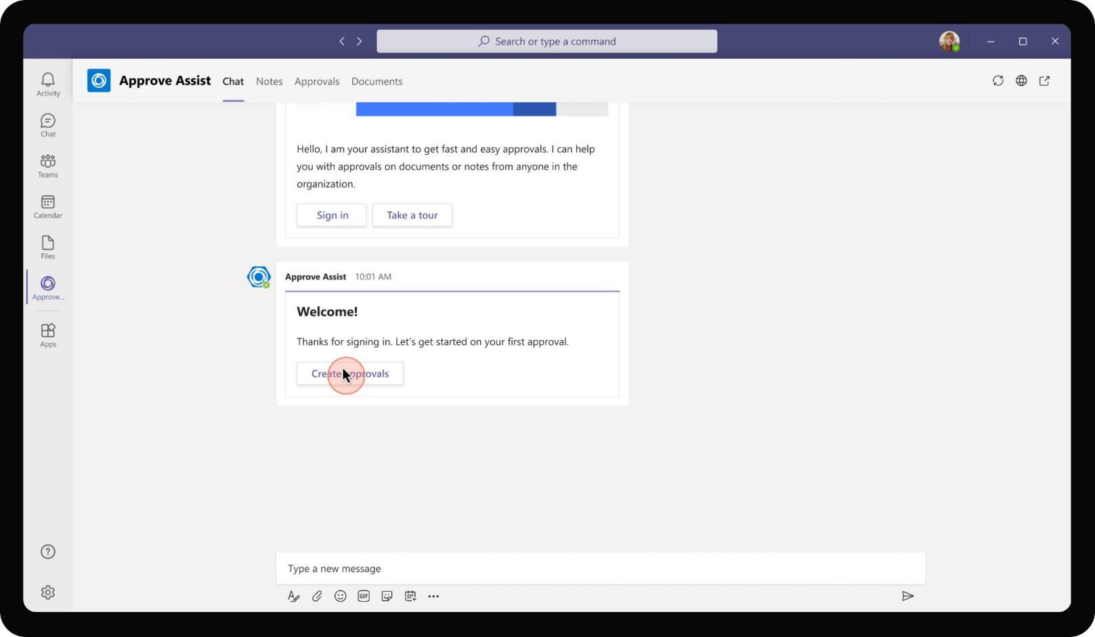
Banking & Financial Services – Approval Assistant
Danila gets to create her first approval by clicking on the bot message. In addition to this entry point, the app also has a bot menu command that allows Daniela to create approval requests at any point of time.

Slide 64
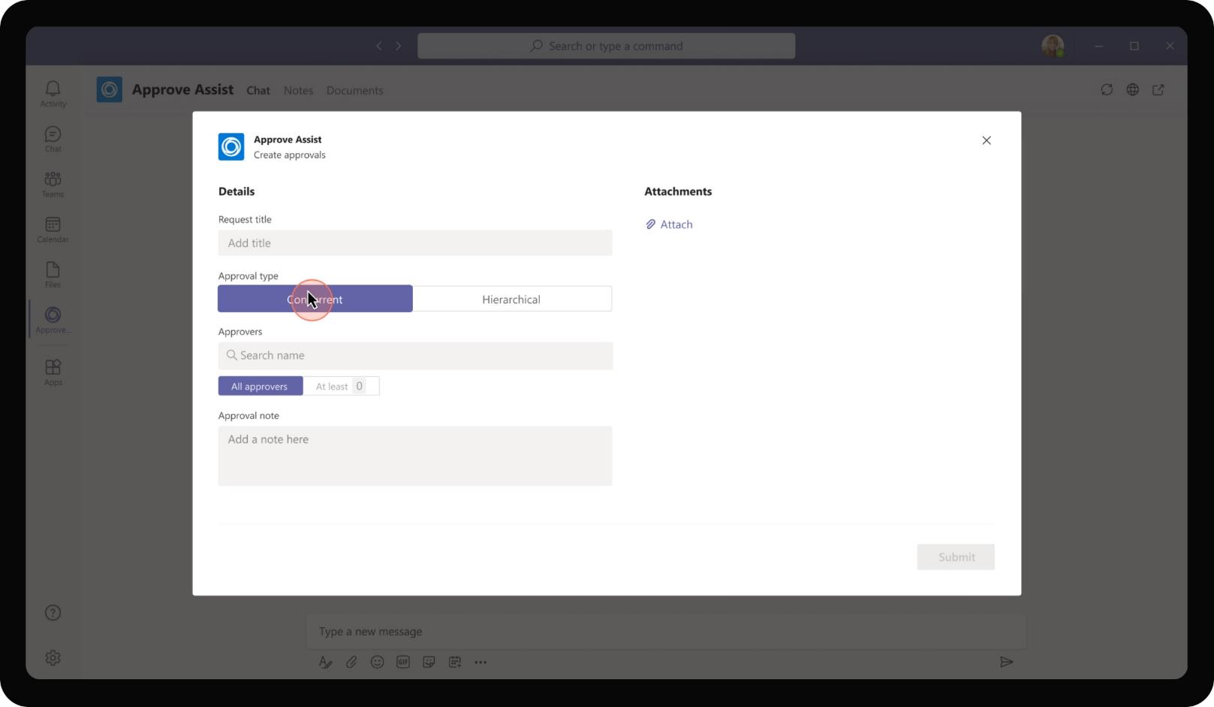
Banking & Financial Services – Approval Assistant
The approval creation process allows Daniela to specify details around the type of approval required. Concurrent approval is to be used when multiple people have to approve an item and the order of approval does not matter. All approvals can happen simultaneously

Slide 65
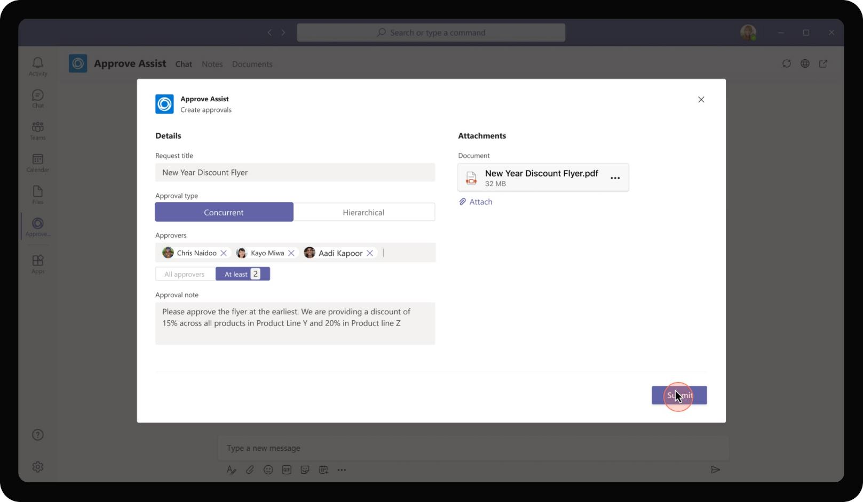
Banking & Financial Services – Approval Assistant
Under concurrent approvals, Daniela has to choose if she requires approvals from all approvers in order to move forward or if partial number of approvers would suffice

Slide 66
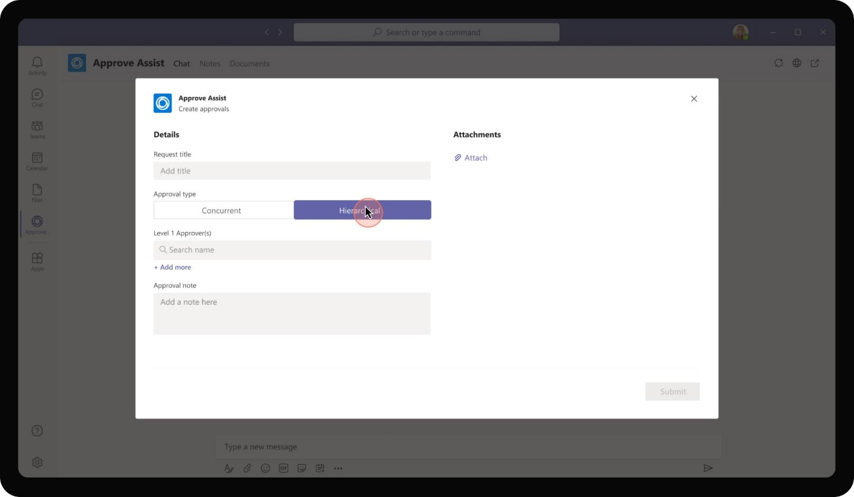
Banking & Financial Services – Approval Assistant
The app also provides option to get hierarchical approvers. This is to be chosen when the approval has to happen in a specified order. This is typical in scenarios where there are multiple levels of approval and the item to be approved goes to each level after being approved in the previous level.

Slide 67
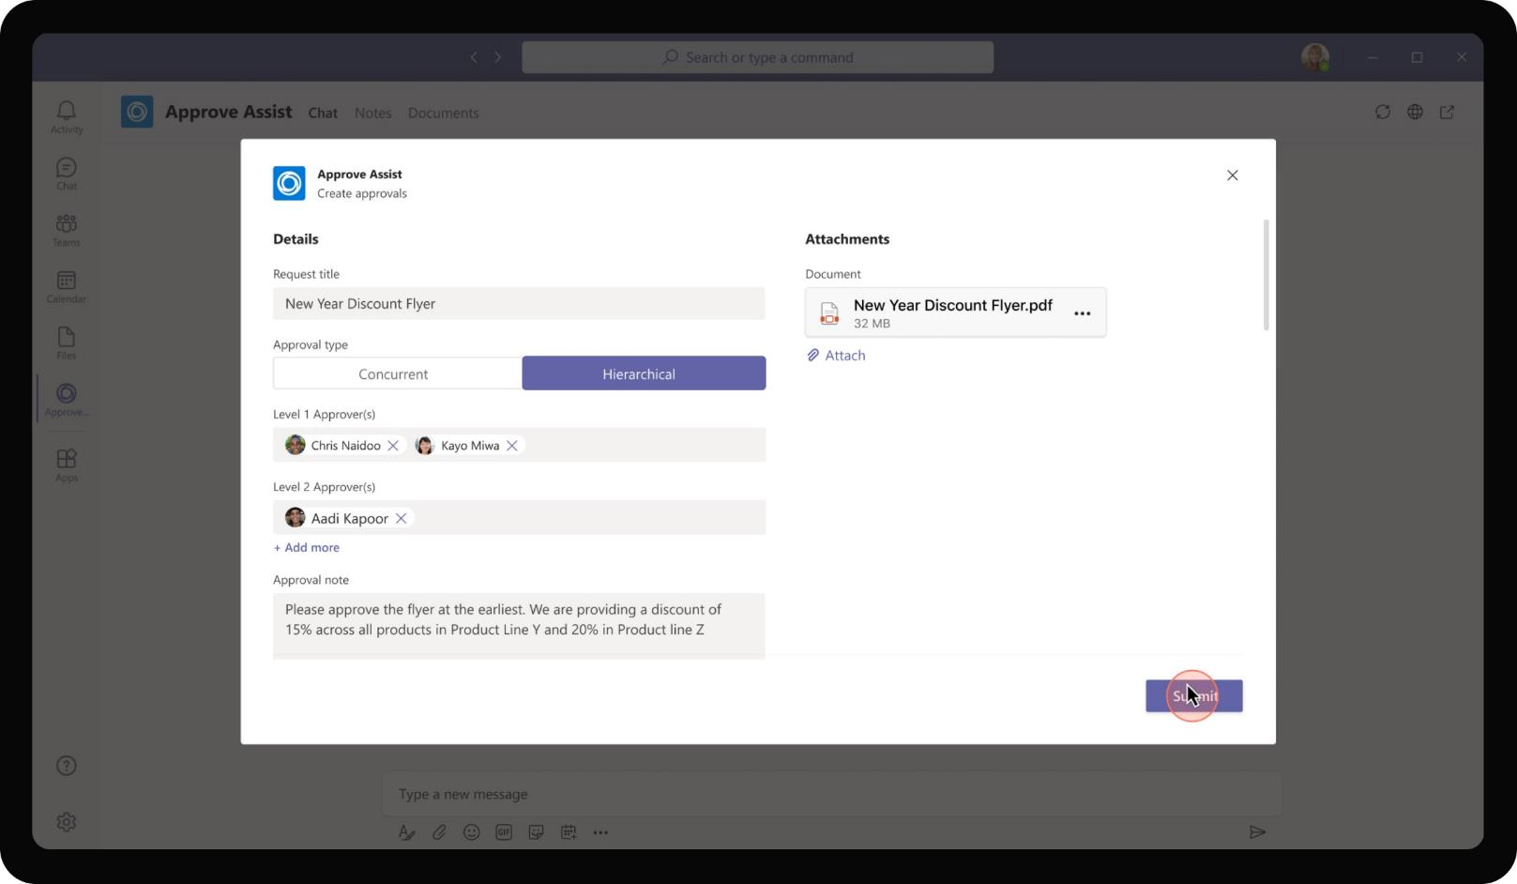
Banking & Financial Services – Approval Assistant
If Hierarchical option is chosen, the app provides Daniela with option to provide approvers in each level of approval. Once all levels are complete, the item is considered to be approved.

Slide 68
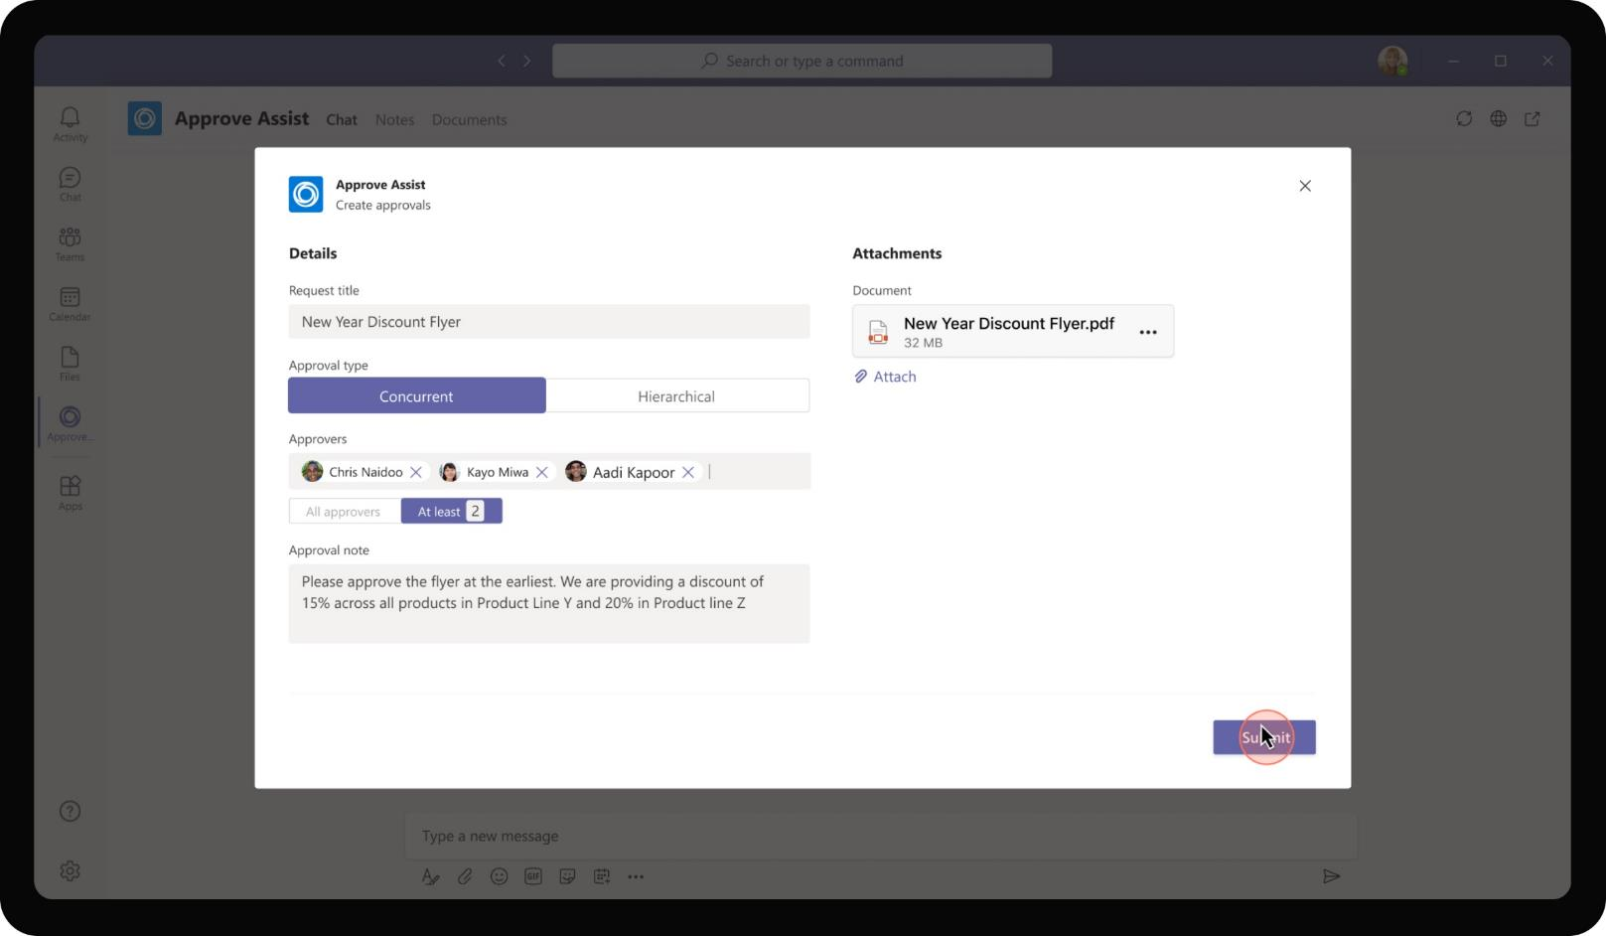
Banking & Financial Services – Approval Assistant
For the New Year Discount Flyer that Daniela has designed, she chooses to get concurrent approvals from at least 2 approvers of the total of 3 people in the approval list.

Slide 69
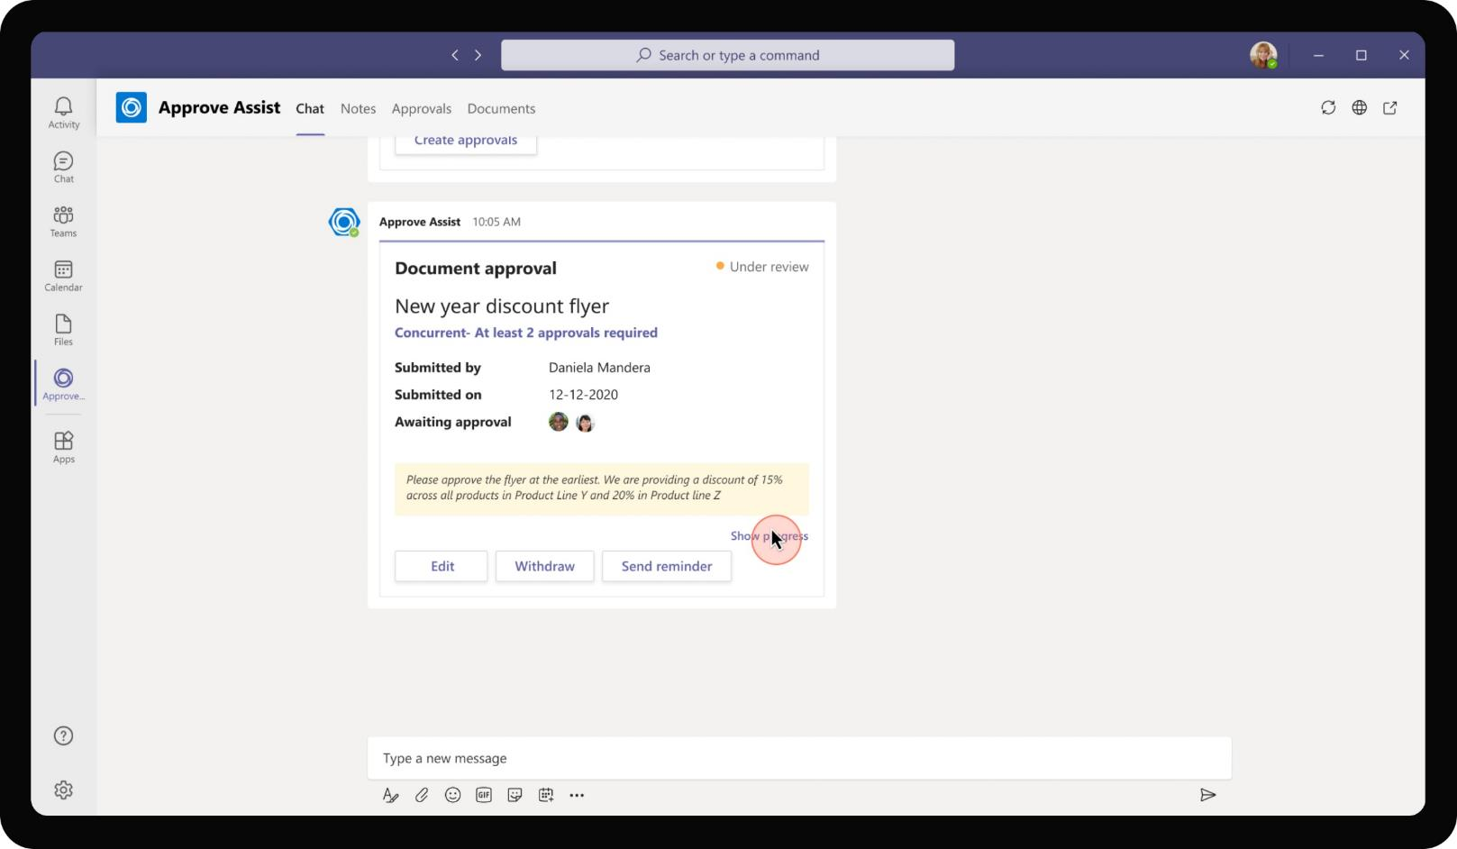
Banking & Financial Services – Approval Assistant
As Daniela submits the approval request, the app presents an adaptive card that shows the approval note, current status of approval and approvers that Daniela is waiting for.

Slide 70
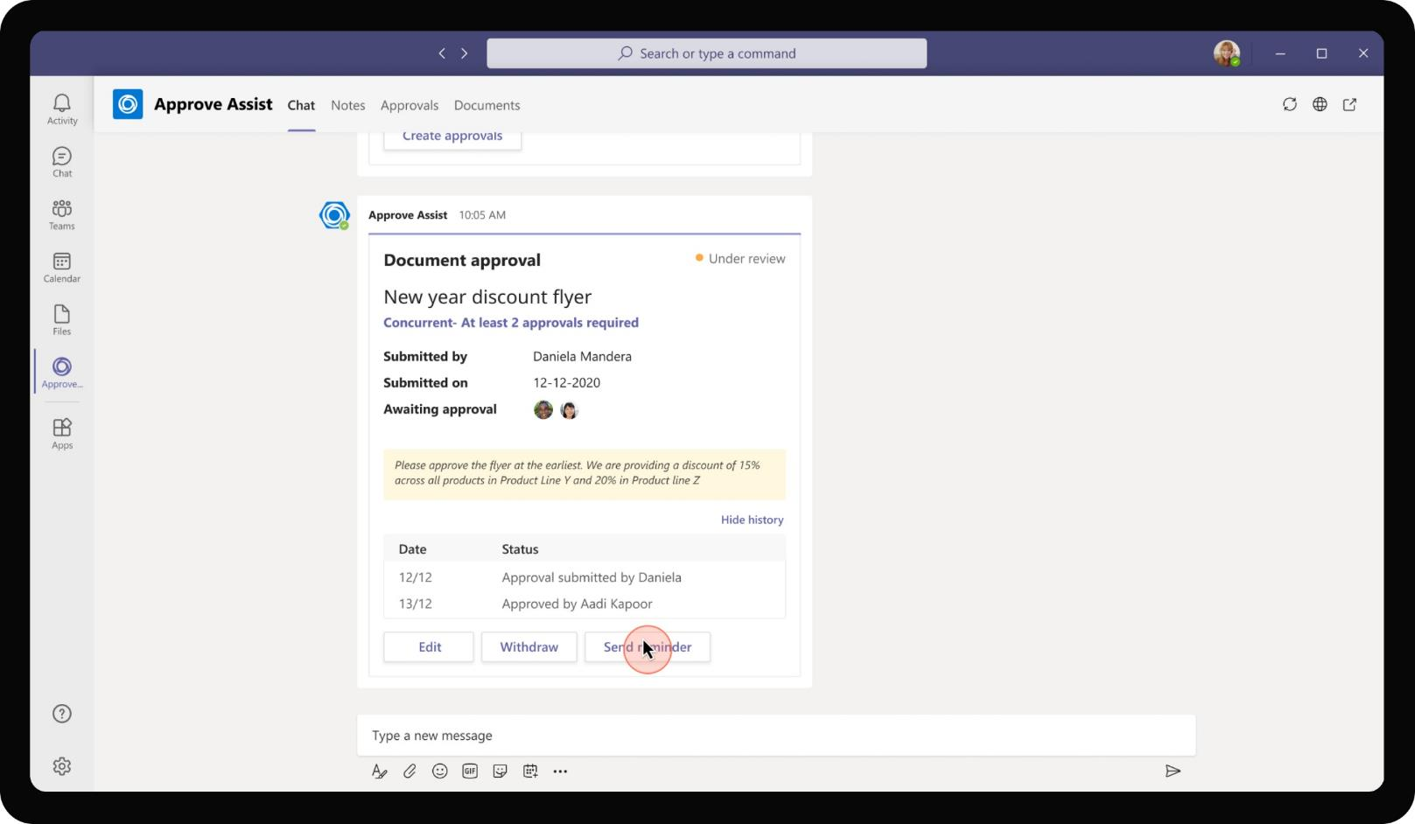
Banking & Financial Services – Approval Assistant
Daniela is also presented with an audit log of approvals, comment activities that occurred in the app organized by date of activity. This provides a good view of progress especially on multi level approvals. Daniela may also choose to send a reminder for pending approvers

Slide 71
Chris, one of the approvers gets Daniela’s approval request. He reviews the request and provides a few comments on the flyer

Slide 72
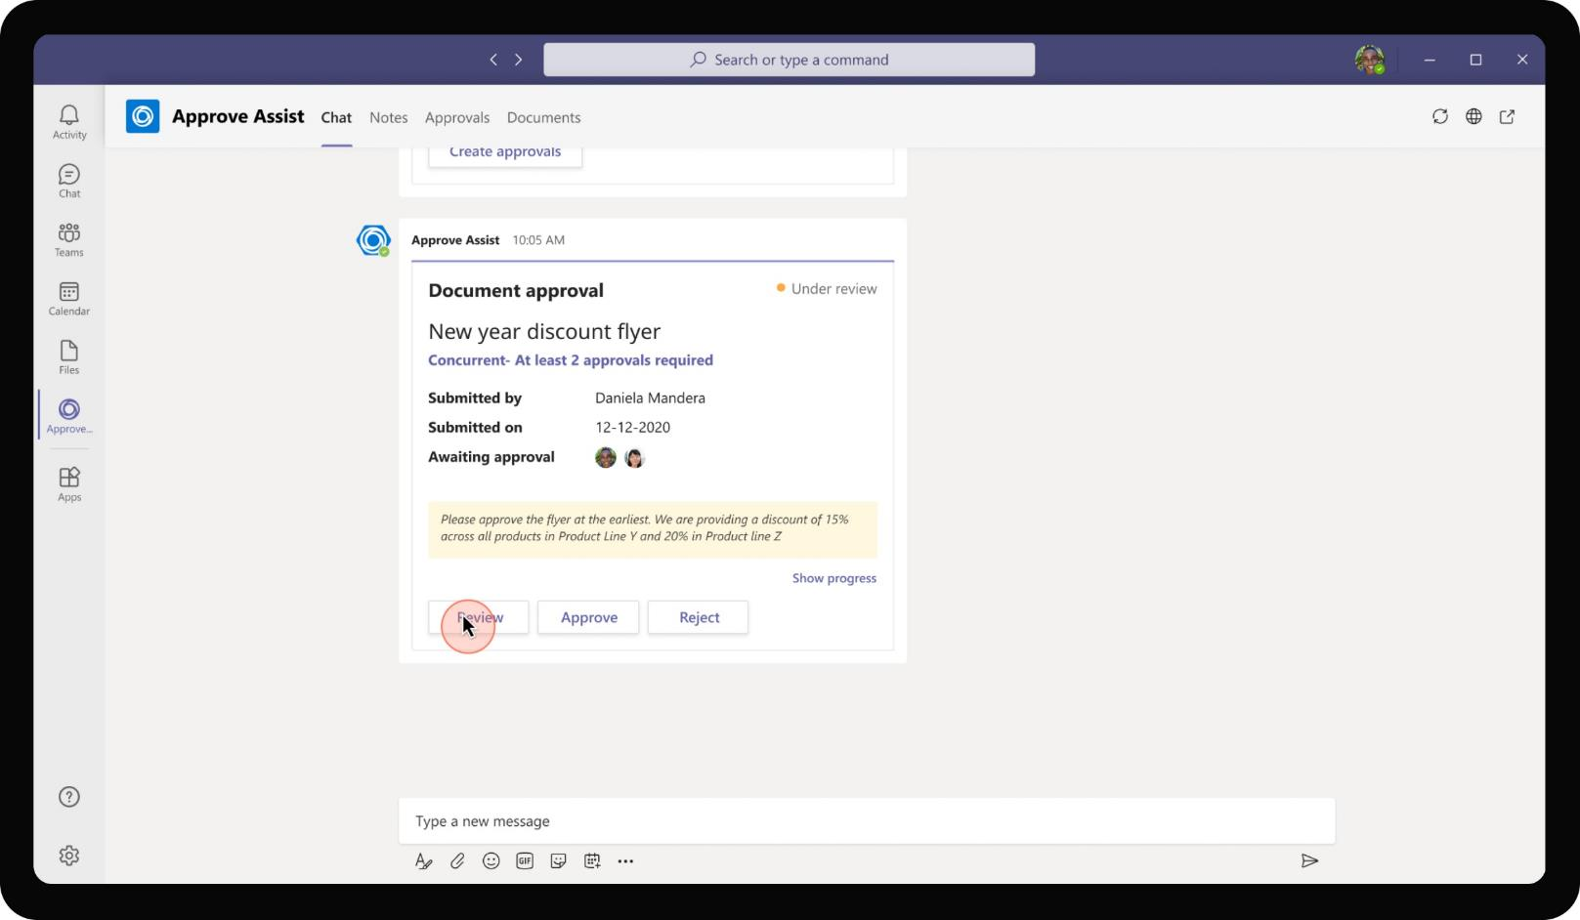
Banking & Financial Services – Approval Assistant
Chris checks the incoming approval request and clicks on Review button to check the details.

Slide 73

Banking & Financial Services – Approval Assistant
Chris sees the status of approvals with other approvers and note from Daniela highlighted separately for approvers. He then proceeds to view the attached document to review the content.

Slide 74

Banking & Financial Services – Approval Assistant
The attached pdf opens within Teams surface and Chris skims through the document. After reviewing, he closes the document and gets back to review screen

Slide 75

Banking & Financial Services – Approval Assistant
He proceeds to write a comment to remove Product Y from the list of product offers in the comment log. This comment log is visible across all approvers who will open the review screen to approve. Chris returns the item for Daniela to work on the modification

Slide 76

Banking & Financial Services – Approval Assistant
Daniela sees that the document has been returned with comments from Chris. She clicks on Edit to view the comments.

Slide 77

Banking & Financial Services – Approval Assistant
She proceeds to modify the document as per the comments and re-attaches the document. Daniela also mentions in the comment log of the change she had made so that Chris and other approvers are aware of the modifications. She then submits for approval again.

Slide 78

Banking & Financial Services – Approval Assistant
The audit log updates to show that the document has been submitted again for approval by Daniela.

Slide 79

Banking & Financial Services – Approval Assistant
After reviewing thoroughly, approver decides to approve the item submitted by Daniela.

Slide 80

Banking & Financial Services – Approval Assistant
After at least 2 approvers approved the flyer, Daniela gets notified that the document has been approved. The card also allows to export the approved document with the note as a PDF for bookkeeping purposes

Slide 81

Banking & Financial Services – Approval Assistant
For Approvers, the app provides a card view of all approvals with highlights around category of approval. The approvers can also review the items directly from the tab view, by clicking on each approval card.

Slide 82
Solution Highlights – Best Practices
Banking & Financial Services – Approval Assistant
Key Solution Design Considerations
Platform Extension Points
User Experience
Personal Scoped App: The app is designed to be a personal scoped app (with personal tab and personal bot) because the document submitted for approval might of sensitive nature. Except for interaction between approver and requestor, there is little scope for collaboration.
Task Modules are used for the review screen owing to the high degree of UI flexibility required to show a comment log with a chat option. In addition, it also has a file attachment section which necessitates a task module / tab view.
The UI also provides user to choose between approval types which reflects in adding approvers as well. This flexibility is easier built in a web page embedded as an iframe.
Proactive Messages are sent for welcoming users and to send updates about approvals, reminders to relevant stakeholders.
Group Chat: The app uses a comment log to keep track of comments and let approvers and requestors talk among each other. This is used to be less intrusive in terms of messages from each other. If intrusiveness is not an issue, instead of comments log, there could be a deeplink to start a group chat with all parties in the approval list.
Card refreshes are used to minimize the number of cards sent to the end user and reduce overload on user’s chat window by reducing the number of cards sent for the same content to be reviewed. This is crucial as one Approval adaptive card keeps getting updated to show progress using audit log.
Graph API
The app uses Files Graph API to upload and update files in SharePoint library.

Slide 83

Solution Architecture
Banking & Financial Services – Approval Assistant
Azure Subscription
AAD
Employee
(Requestor)
SSO
Bot / Task Module / ME
Create request, Approve request
GET / POST attachments
Bot Registration
Approve Assist
App Service
SharePoint Document library
MS Teams
GET / POST File blobs, conversation IDs
Employee
(Approver)
Comments & Audit status
Approvals

